Slide 1

UShop User Interface Changes

Slide 2
Affected Screens

Slide 3
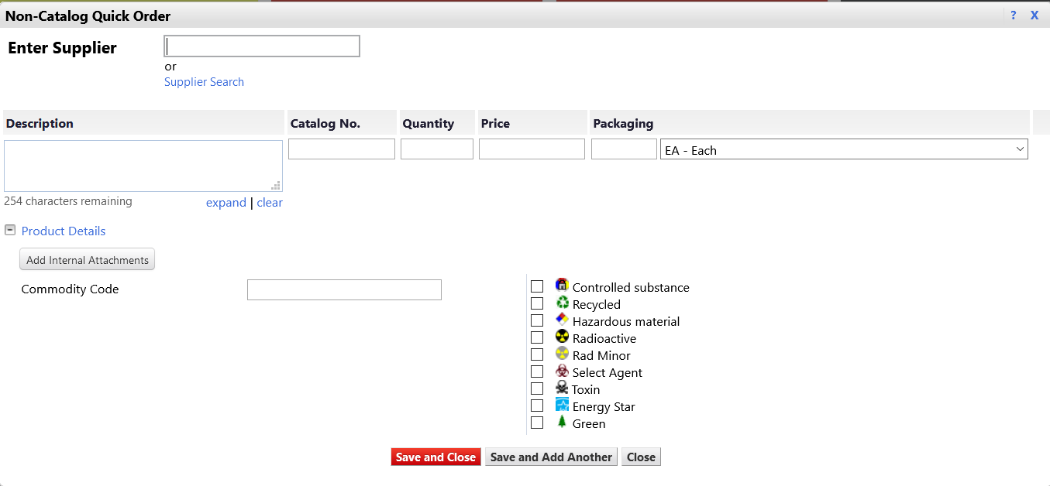
Quick Order - Old

Slide 4
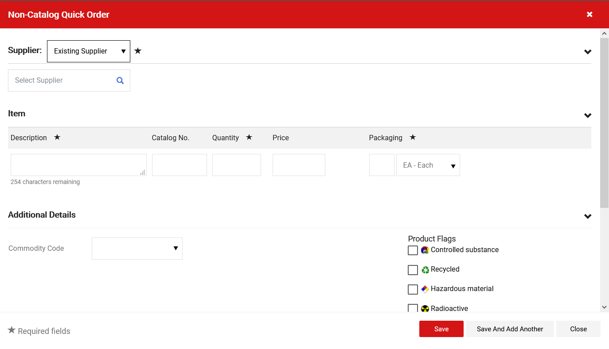
Quick Order - New
Scroll Bar
Select Supplier
DESCRIPTION
CATALOG
QTY
PRICE
PKG
UofM
Save

Slide 5
Shopping Cart Changes

Slide 6
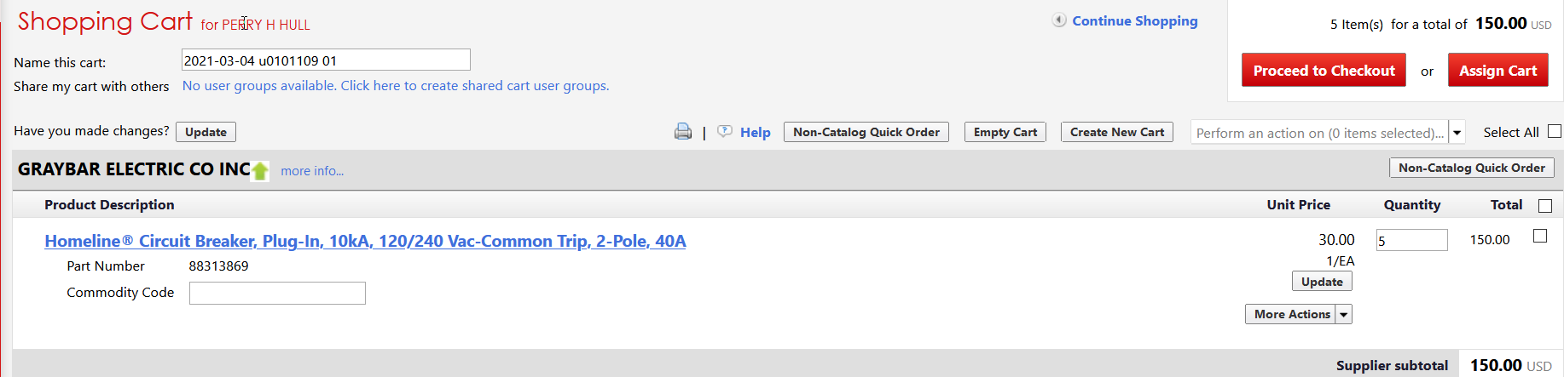
Shopping Cart - Old

Slide 7
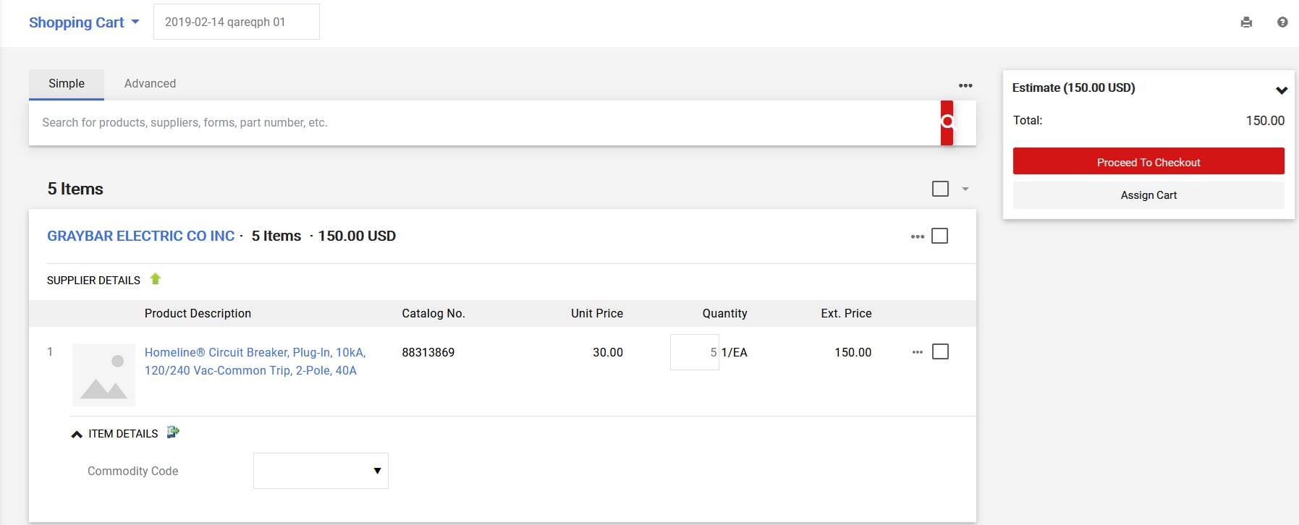
Shopping Cart - New

Slide 8
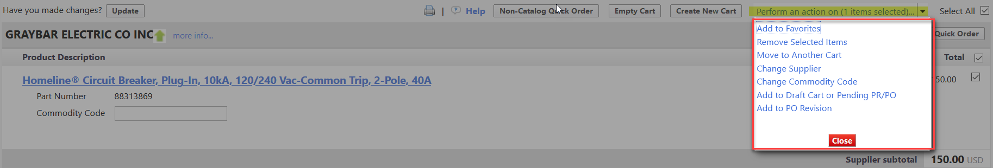
Shopping Cart Options - Old

Slide 9
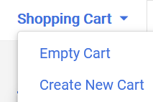
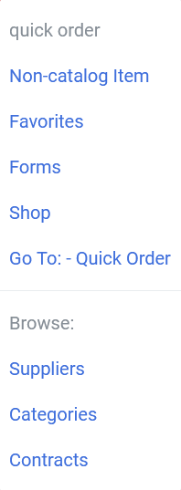
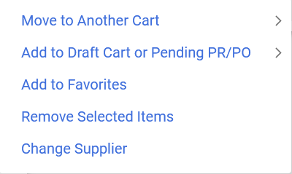
Shopping Cart Options - New
CART NAME
Options
Options

Slide 10
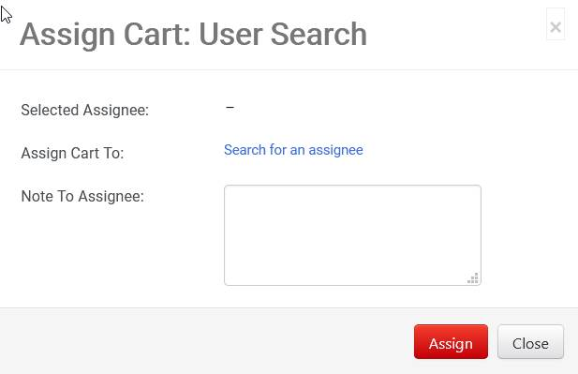
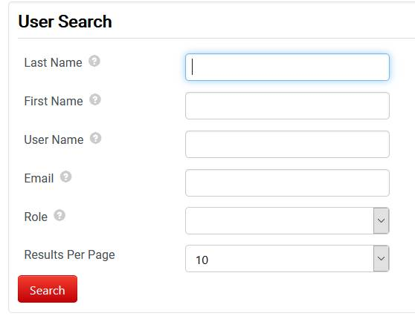
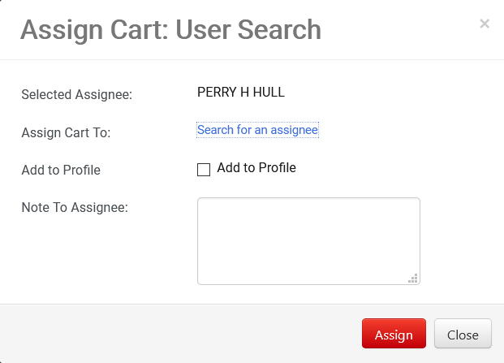
Shopping Cart Assign - Old

Slide 11
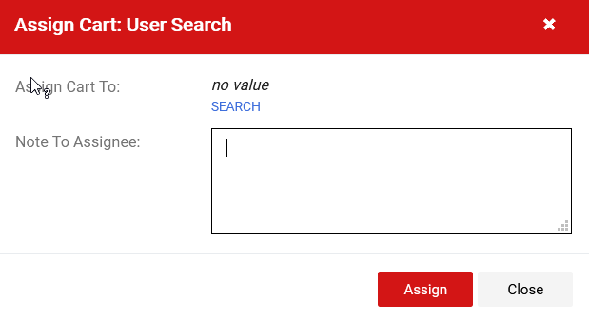
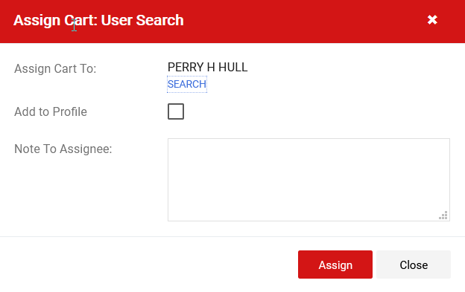
Shopping Cart Assign - New

Slide 12
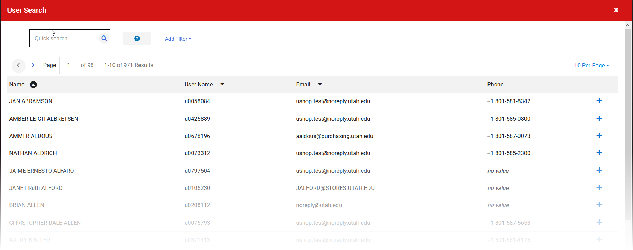
Shopping Cart Assign – User Search

Slide 13
Requisition Changes

Slide 14
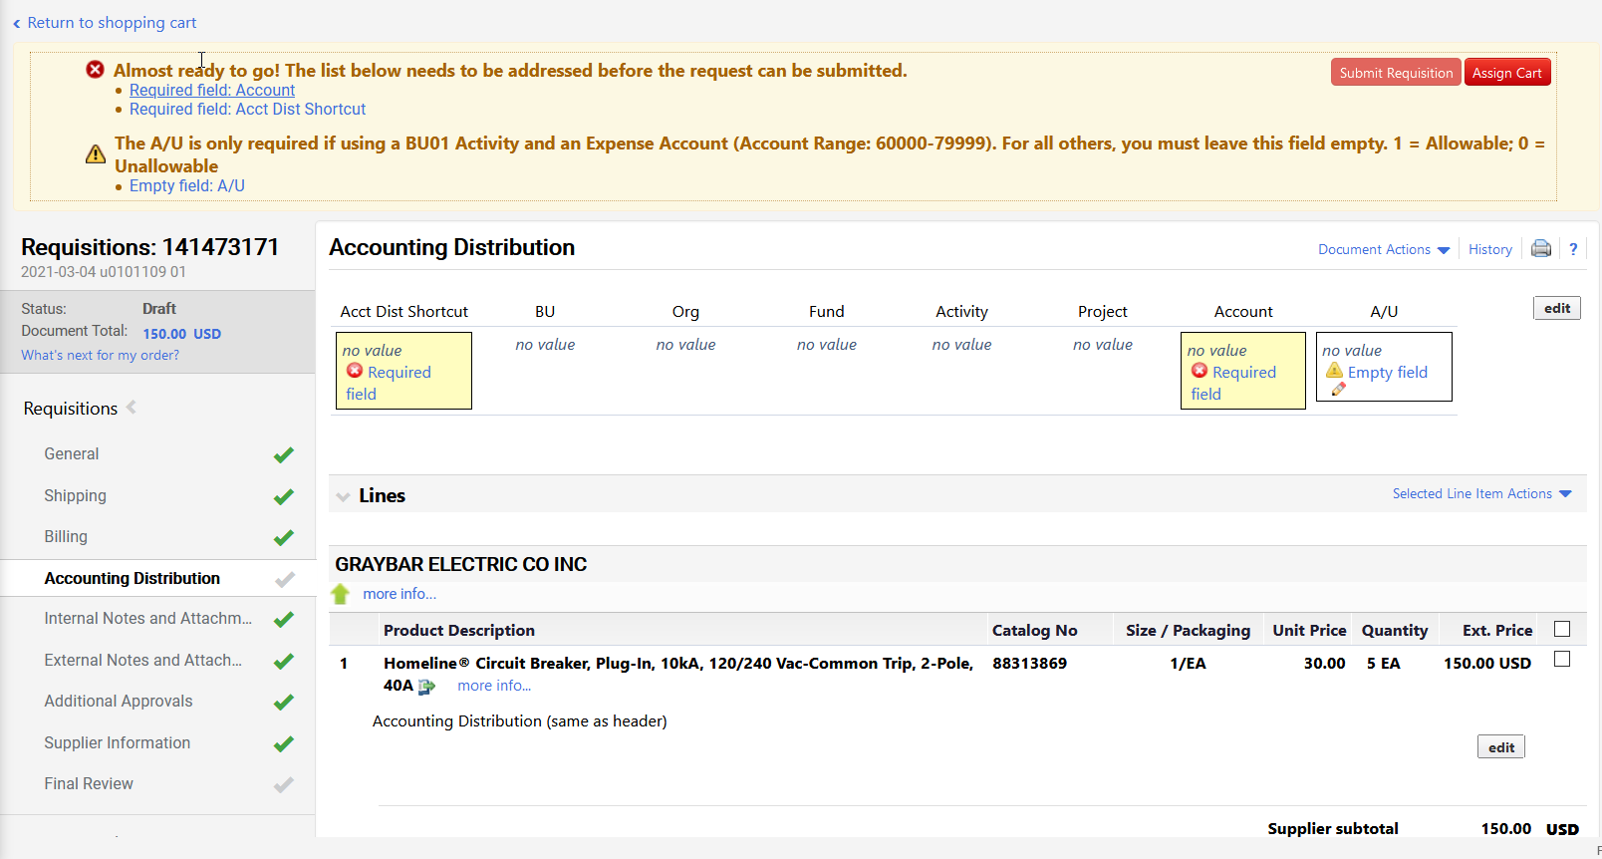
Requisition View - Old

Slide 15
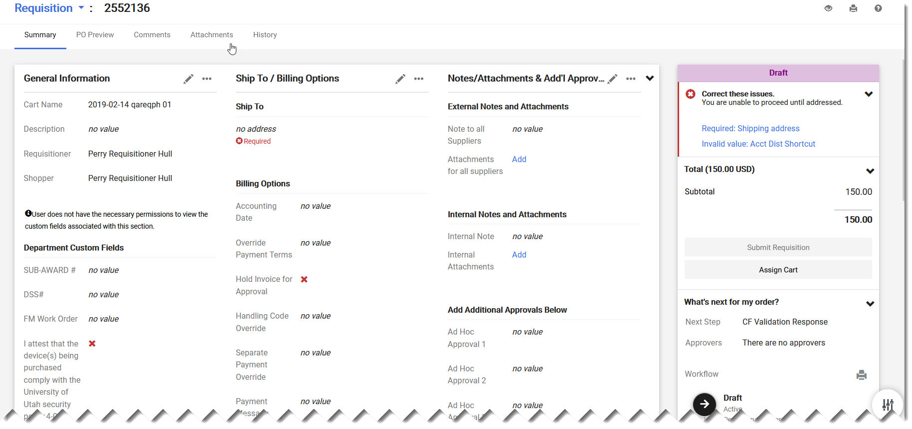
Requisition View - New
General Info
Shipping/Billing
Notes, Attachments
Issues to Address
Departmental Custom Fields
Total Order Cost
Submit/Assign
Additional Approvals
Workflow Steps

Slide 16
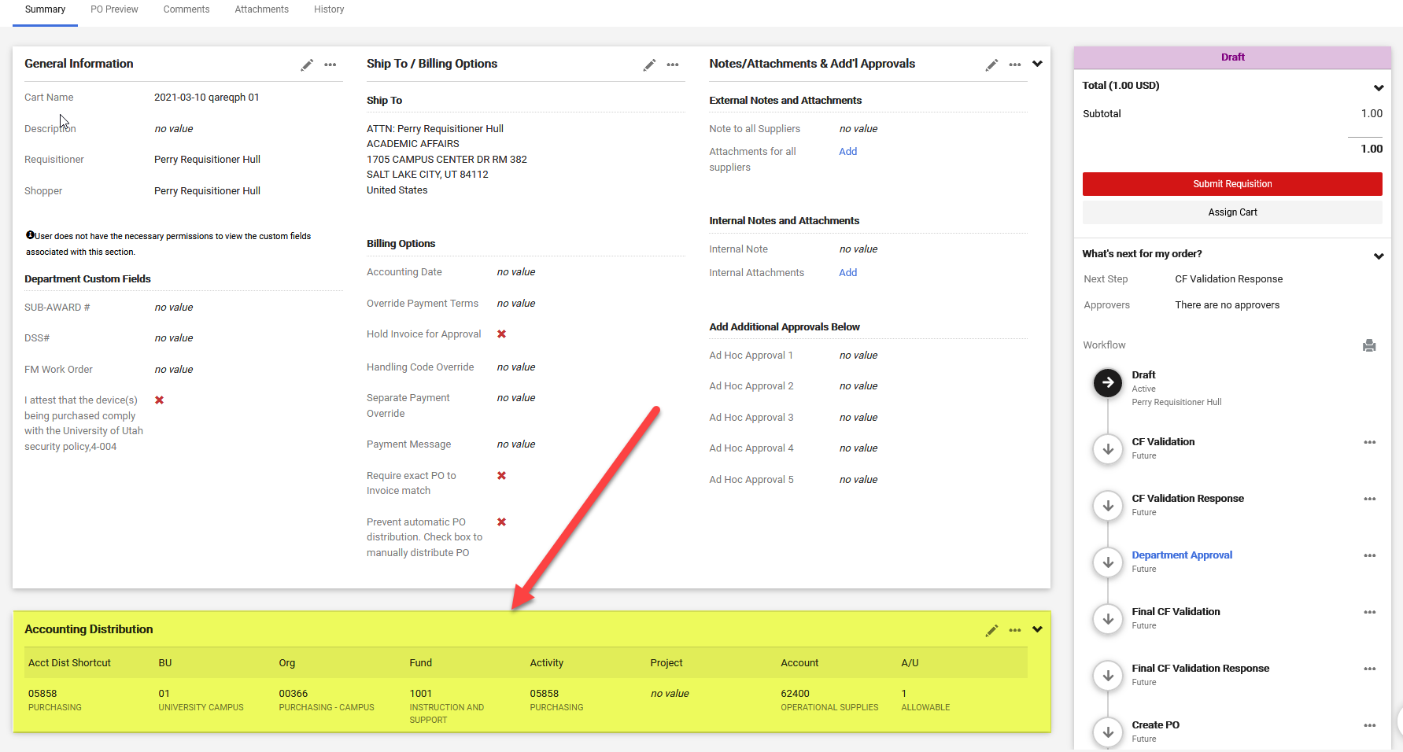
Accounting Distribution Info

Slide 17
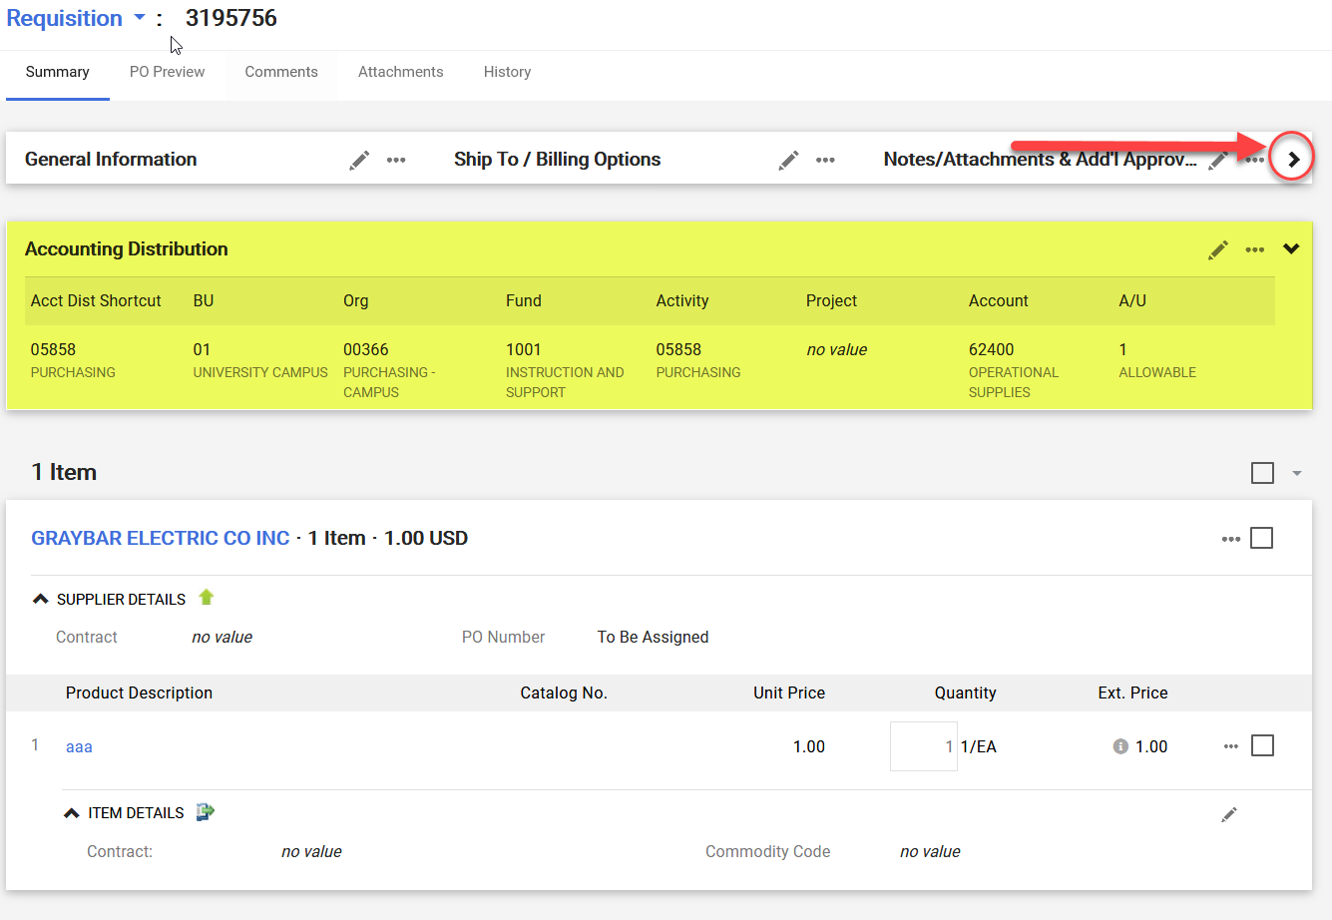
Collapsing Top Section

Slide 18
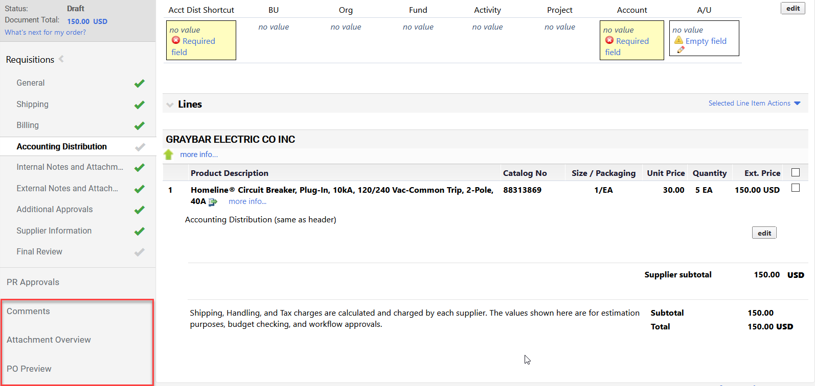
Adding Comments & Attach. - Old

Slide 19
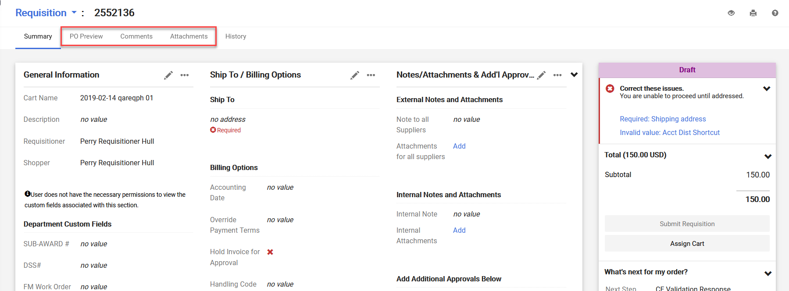
Adding Comments & Attach. - New

Slide 20
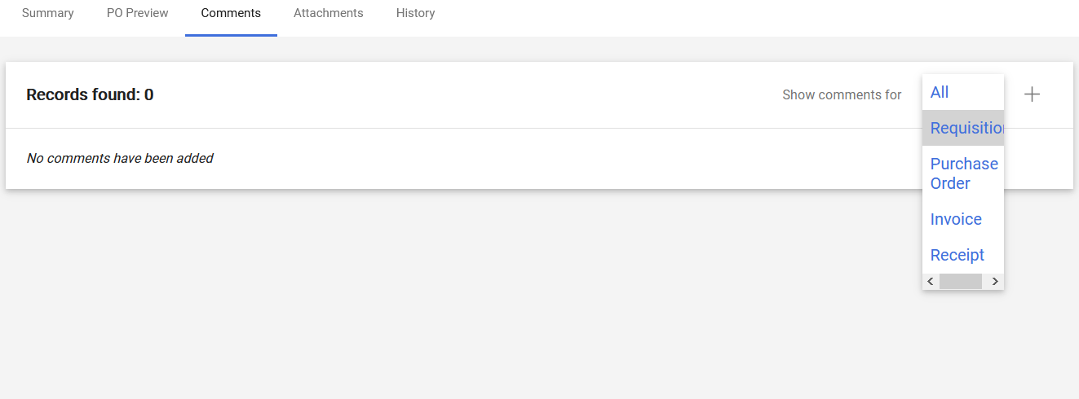
Viewing Comments - New
Select “+” to add comment
Choose from multiple document types

Slide 21
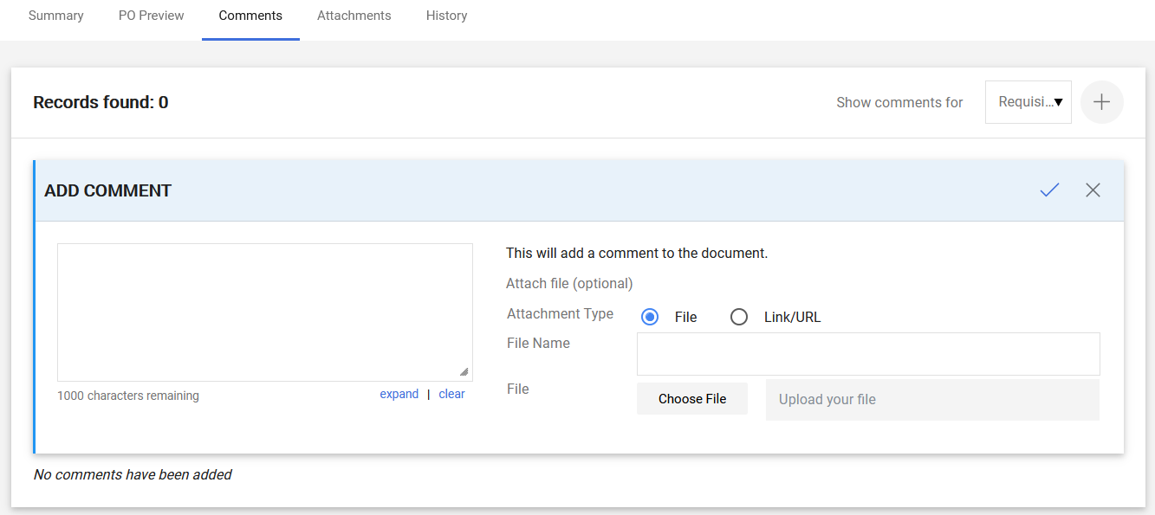
Adding a Comment - New
Select to save

Slide 22
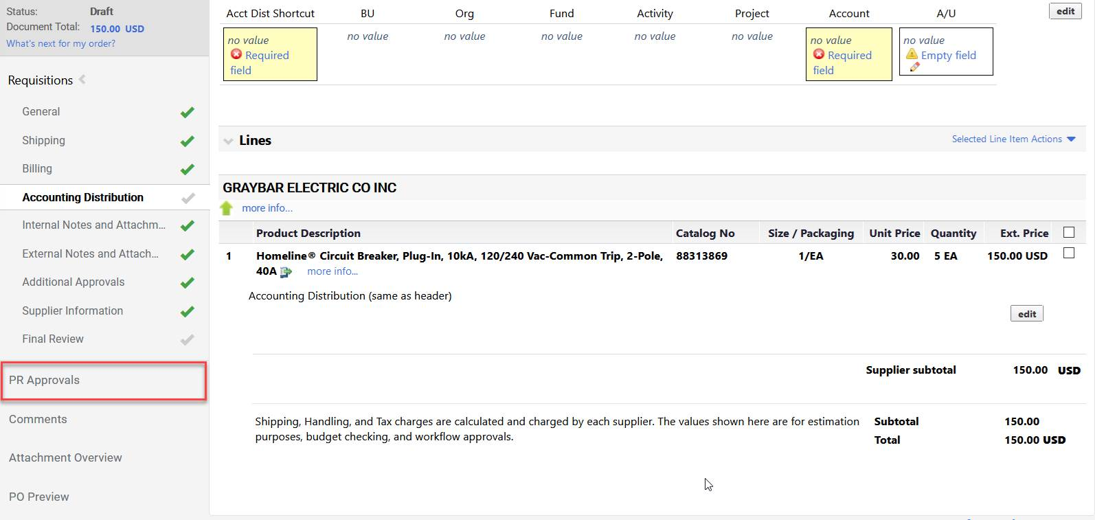
PR Approvals - Old

Slide 23
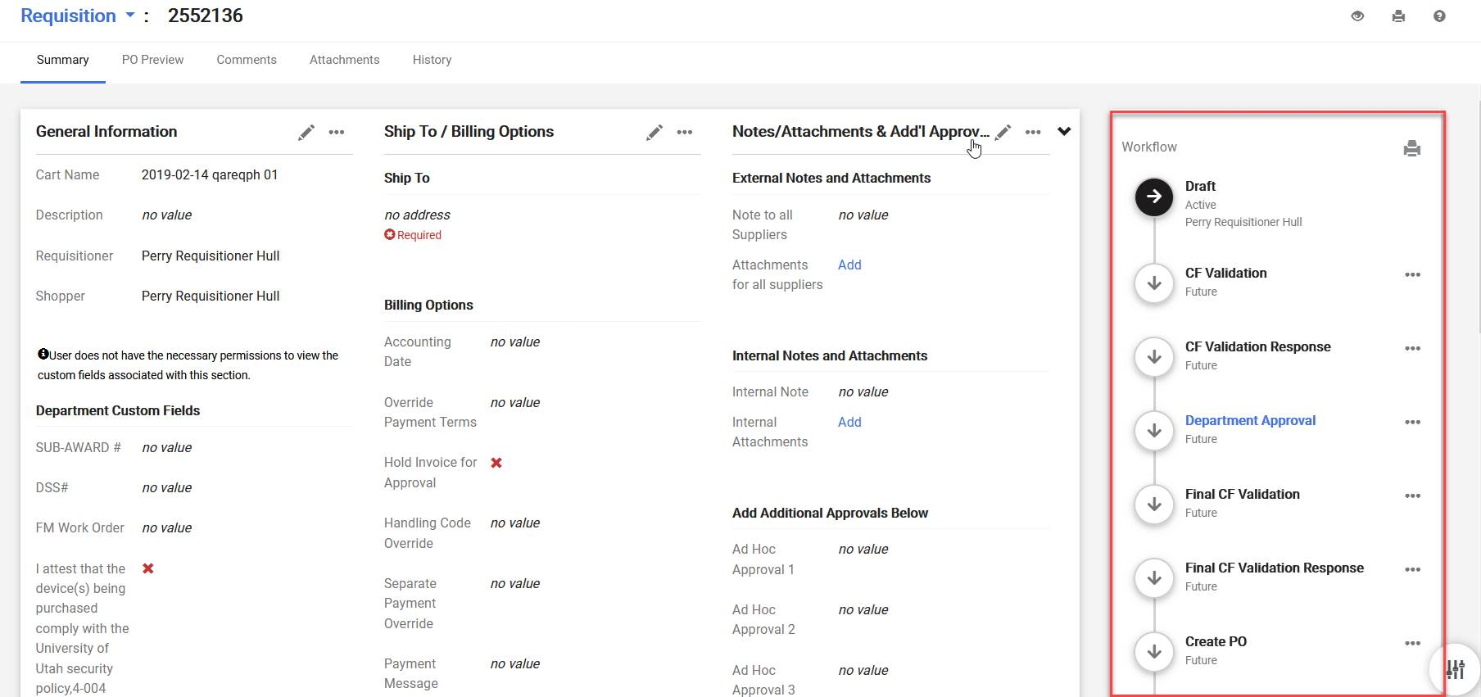
PR Approvals - New

Slide 24
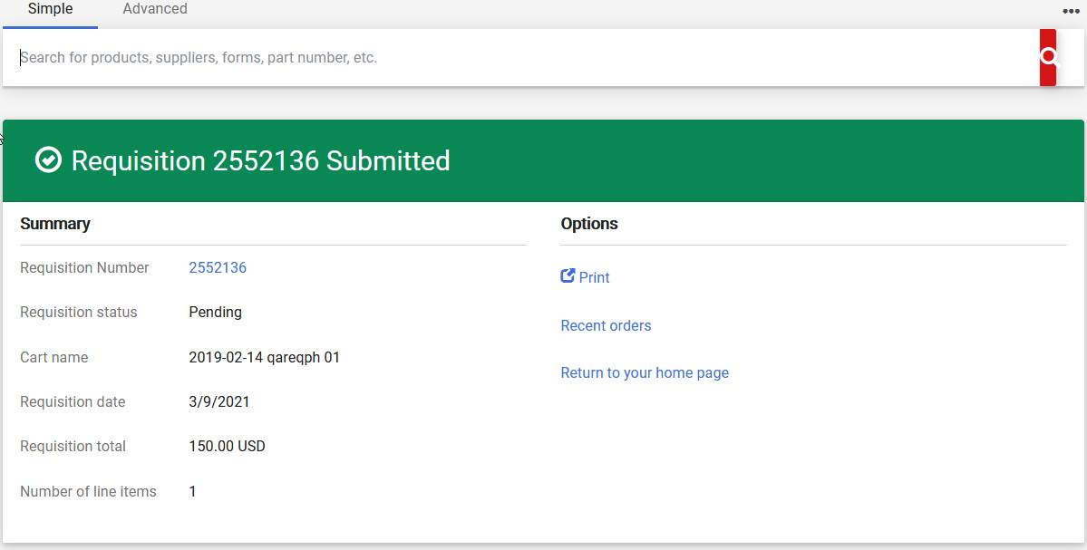
Requisition Submitted - New

Slide 25
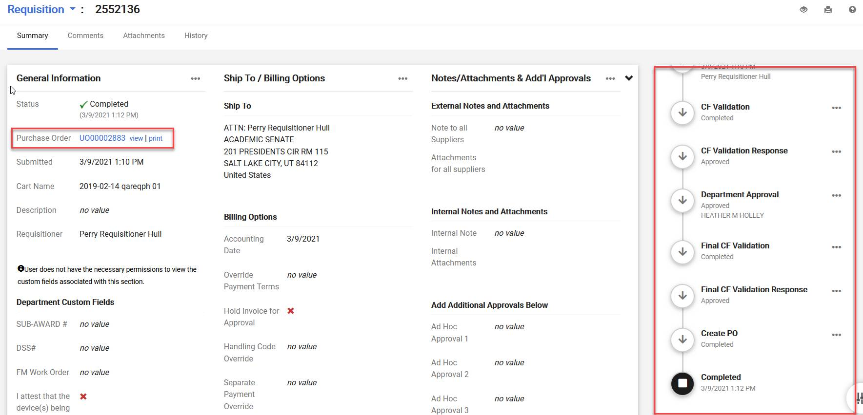
Submitted Requisition Page - New

Slide 26
Purchase Order Changes

Slide 27
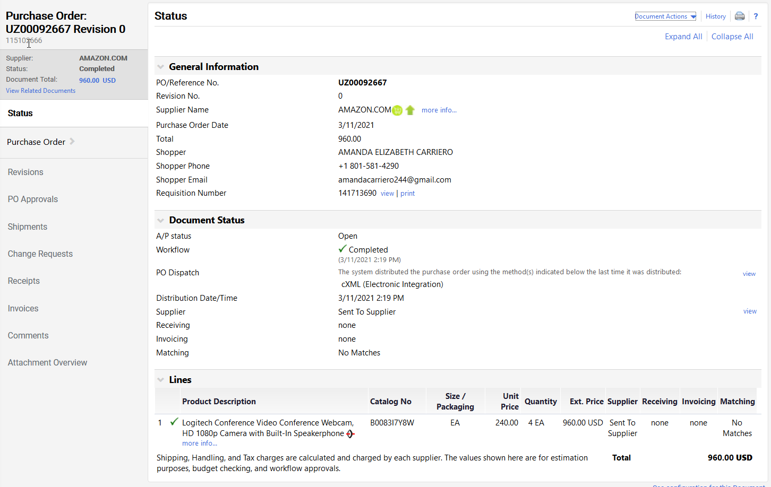
Purchase Order - Old

Slide 28
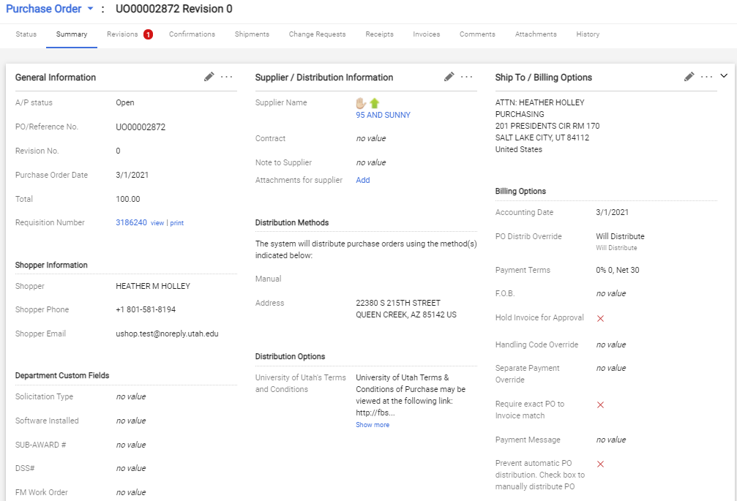
Purchase Order - New
General Info
Shipping/Billing
Ship To
Billing Options
Distribution Methods
Shopper Information
Departmental Custom Fields
Distribution Options

Slide 29
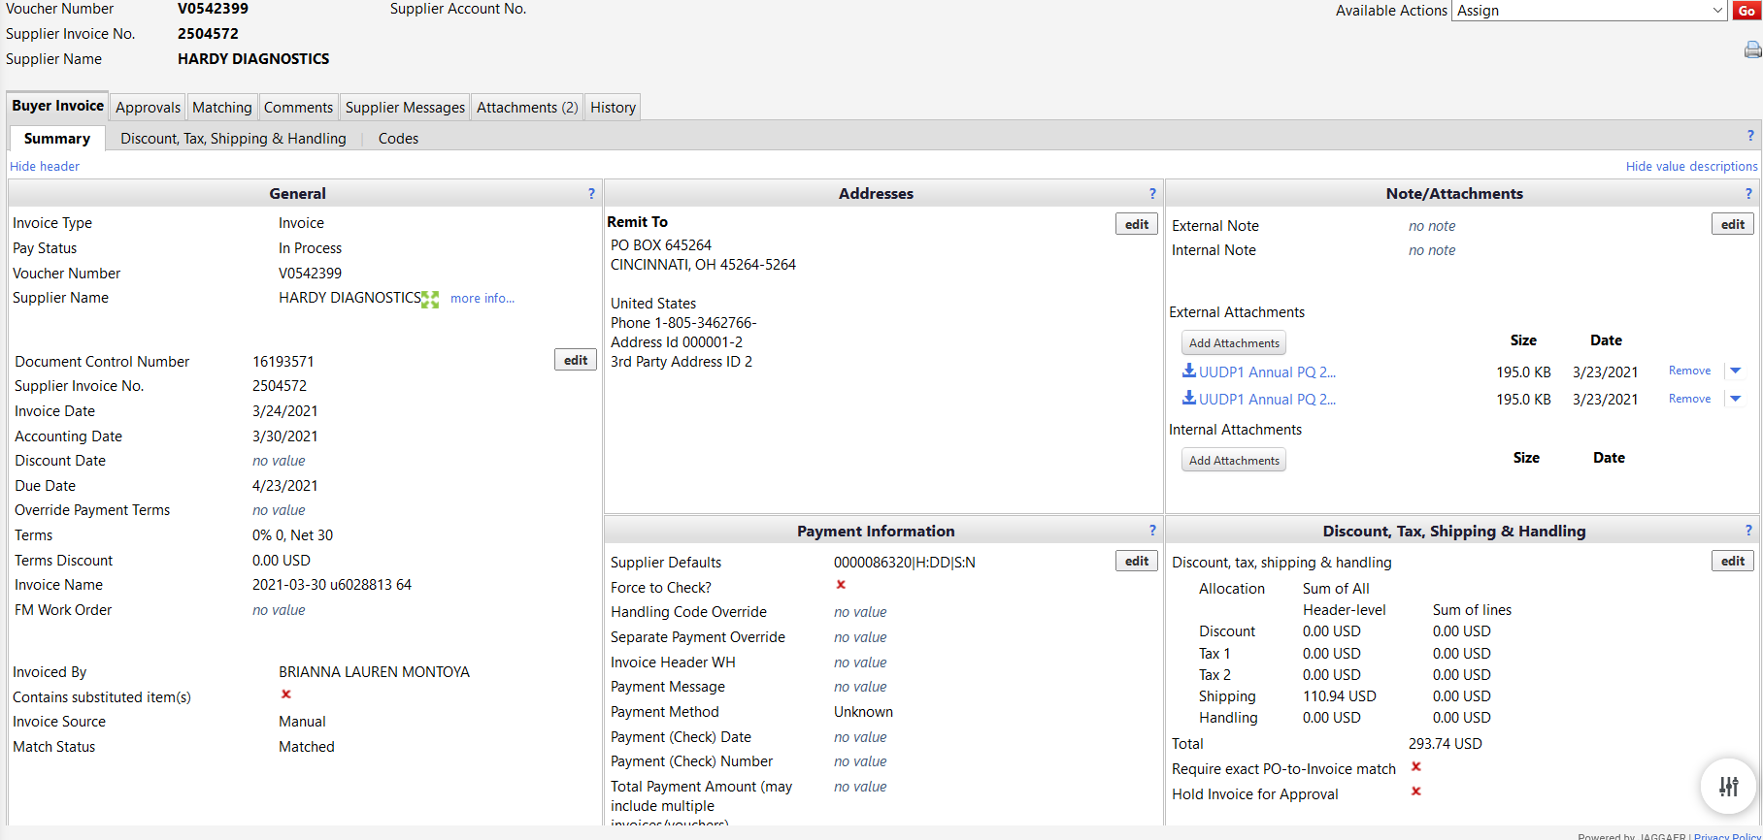
Invoice Layout - Old

Slide 30
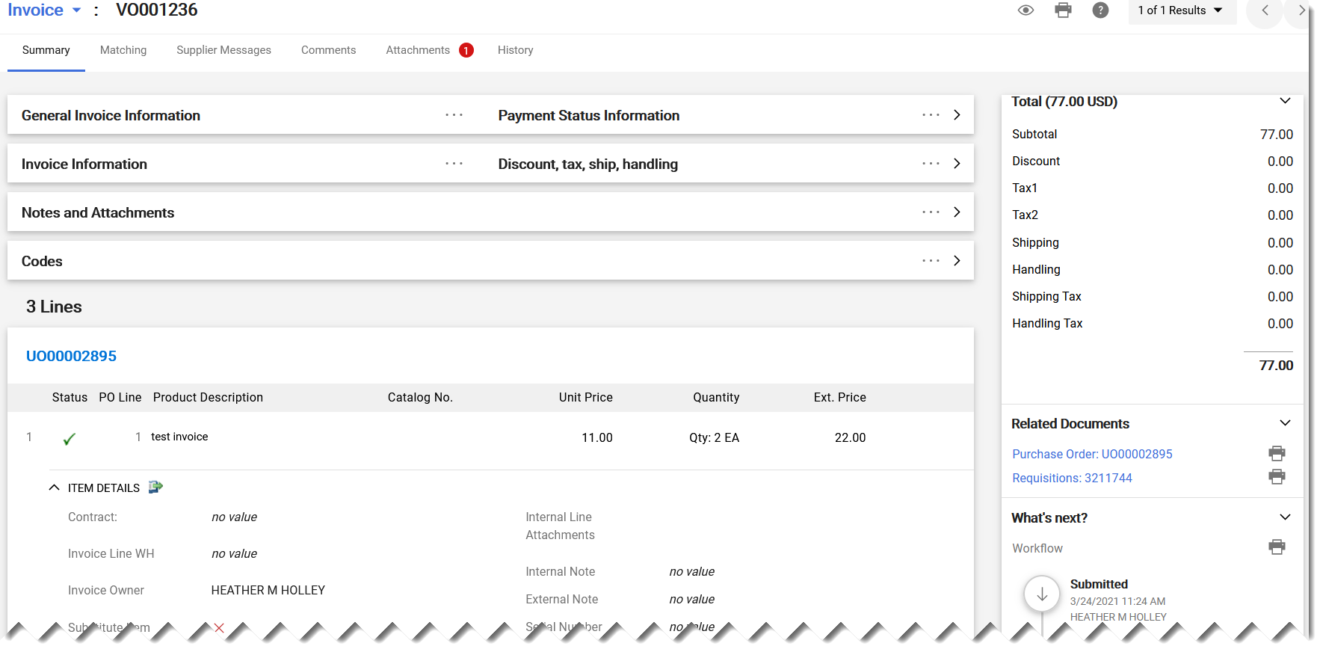
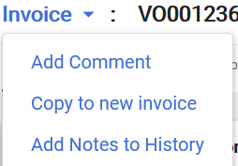
Invoice - New
Invoice Total Breakdown
Collapsible Headers
Invoice Lines
Related Documents
Invoice Workflow

Slide 31
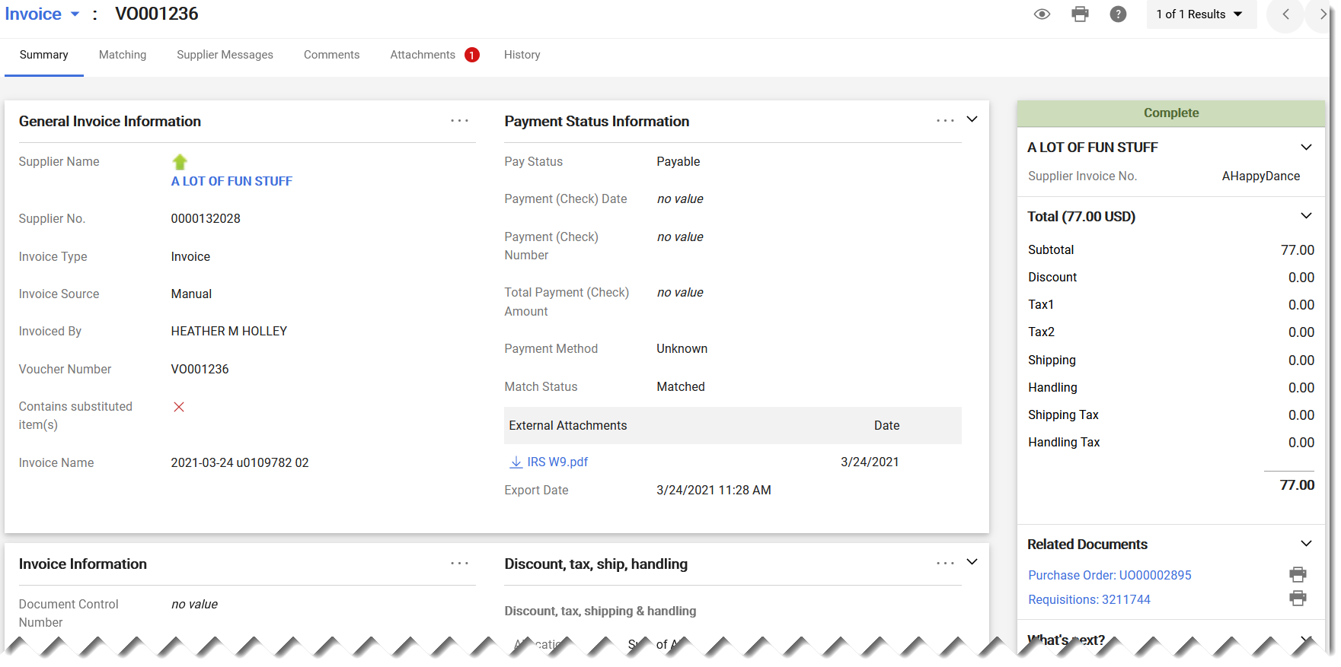
Invoice – Section One
General Info
Payment Information

Slide 32
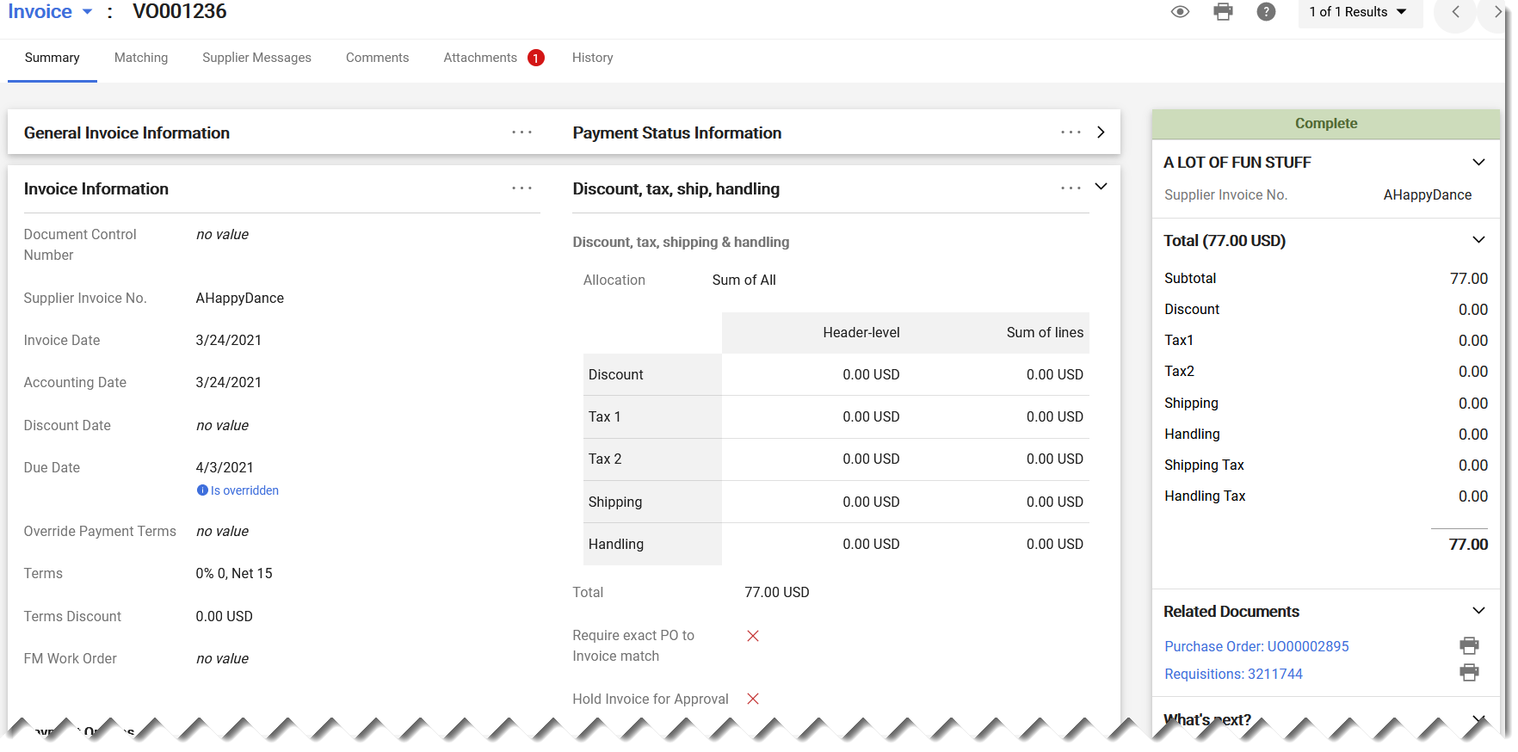
Invoice – Section Two
Invoice Details
Invoice Total Breakdown

Slide 33
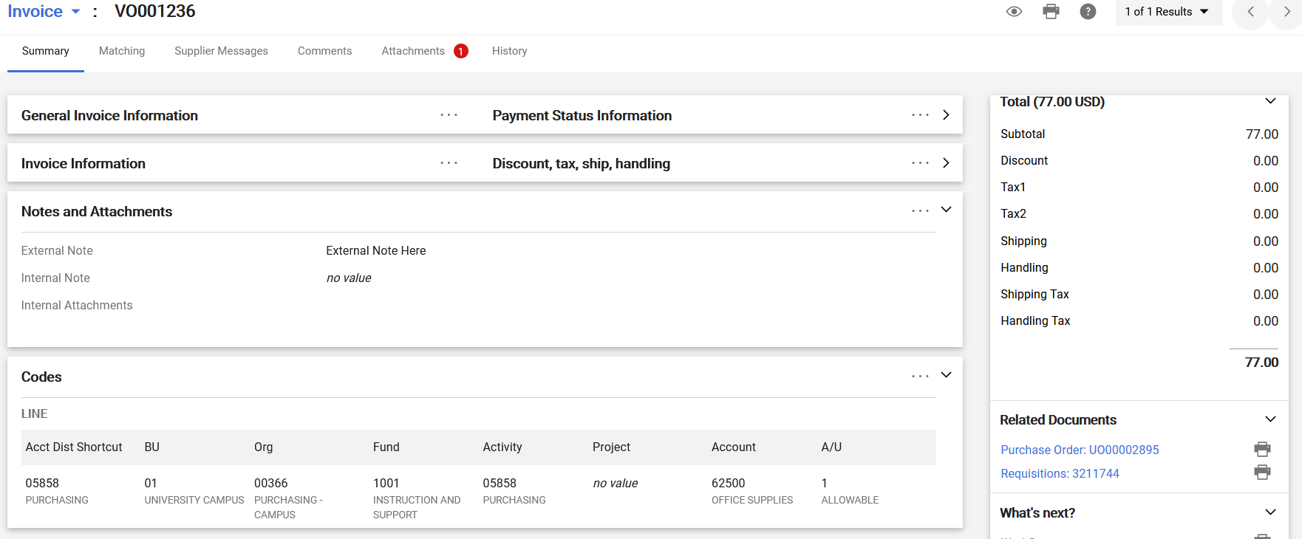
Invoice – Sections 3 & 4
Notes & Attachments
Accounting Codes

Slide 34
New Interface - Support
Document listing the icon changes from old to new interface
  https://fbs.admin.utah.edu/download/ushop/interface-changes-key.pdf
UShop Help Desk
  Email: ushop@utah.edu
  Phone: 5-CALL

