Slide 1

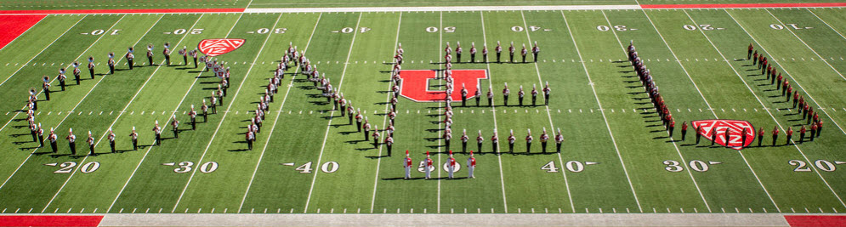
FINANCIAL & BUSINESS SERVICES
Electronic Procurement and Payment System
Requisitioner Training
11/17/22 HH
  2022 | University of Utah | Financial Services

Slide 2
FINANCIAL & BUSINESS SERVICES
UShop Training Materials – Table of Contents
Requisitioner – beyond Shopping
Shopper Training should be completed prior to this training
Checklist
Requisition Workflow
Approving Orders
Purchase Orders
Change Orders
Invoicing & Payment
Closing Purchase Orders
Reports & Searching
Tips & Tricks
Help Resources
  2022 | University of Utah | Financial Services

Slide 3

FINANCIAL & BUSINESS SERVICES
Training Required prior to beginning Requisitioner Training
If you will be performing shopping tasks in UShop, you should have already completed viewing the Shopper training, which can be found using the link below. If your role in the department is only to review and approve orders created by Shoppers, and you won’t be shopping, then you can simply view this training
Follow the link below to view Shopper training material now
Shopper Training
  2022 | University of Utah | Financial Services

Slide 4
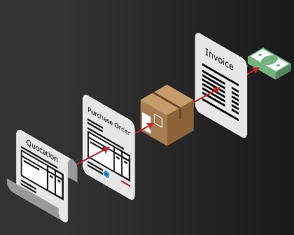


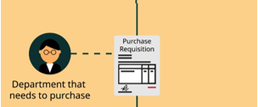

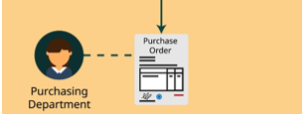


FINANCIAL & BUSINESS SERVICES
Definitions
The following terms will be used throughout this training and will be important to know for the best outcomes.
A quote is a document that a Supplier (seller) provides to a buyer to offer goods or services at a stated price under specified conditions.
Quote
Requisition
A purchase requisition form is an internal document used to request the purchase of goods or services.
A purchase order (PO) is a legal document (contract) that buyers send to a Supplier (seller) to document the request of a sale of products and/or services. This document also states payment and other terms which have been agreed upon by both parties.
Purchase Order
(PO)
Invoice
From a buyer's point of view, an invoice is a document which indicates money that is owed from the buyer to the Supplier (seller). On an invoice the Supplier indicates money due, payment terms, and a payment due date.
Invoice
Invoice
  2022 | University of Utah | Financial Services
  2021 | University of Utah | Financial Services

Slide 5





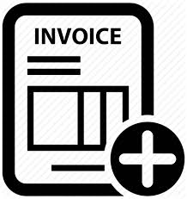


UShop Process Overview
The system was designed to help you touch the transaction once and allow the system to do the rest on your behalf
Shop
Proceed to
Checkout
Review & Approve
Purchase Order
Order Received
Invoice
Received
Supplier
Paid
Shop using:
Punch-out Catalogs
Quick Order
Purchasing Forms
Checkout:
Shipto Address
Accounting Distribution
Optional Checkout Features
Approvals:
Routed through Workflow
Department Approval (GFA)
Purchasing (order over 5K)
GCA (projects)
Purchase Order:
Created by the system
Order sent in the form of a PO to the supplier
The supplier should send the invoice to ap@admin.utah.edu . If they send the invoice to you forward the invoice to A/P and cc the supplier. Make sure the PO number is on the invoice.
  2022 | University of Utah | Financial Services
  2021 | University of Utah | Financial Services

Slide 6
UShop Process Overview
Note the 5 states
Cart – Requisition – Order/PO – Invoice - Payment
Cart
Requisition
Order/PO
Invoice
Payment
Shop
Proceed to
Checkout
Review & Approve
Purchase Order
Order Received
Invoice
Received
Supplier
Paid
Shop using:
Punch-out Catalogs
Quick Order
Purchasing Forms
Checkout:
Shipto Address
Accounting Distribution
Optional Checkout Features
Approvals:
Routed through Workflow
Department Approval (GFA)
Purchasing (order over 5K)
GCA (projects)
Purchase Order:
Created by the system
Order sent in the form of a PO to the supplier
The supplier should send the invoice to ap@admin.utah.edu . If they send the invoice to you forward the invoice to A/P and cc the supplier. Make sure the PO number is on the invoice.
  2022 | University of Utah | Financial Services
  2022 | University of Utah | Financial Services

Slide 7
FINANCIAL & BUSINESS SERVICES
UShop Training Materials – Table of Contents
Requisitioner – beyond Shopping
Shopper Training
Checklist
Requisition Workflow
Approving Orders
Purchase Orders
Change Orders
Invoicing & Payment
Closing Purchase Orders
Reports & Searching
Tips & Tricks
Help Resources
  2021 | University of Utah | Financial Services

Slide 8


FINANCIAL & BUSINESS SERVICES
Summary - Checklist for Order Creation
Create a Requisition (Order) - Shopper
Shop See One UShop page 8 for help
Click Cart Icon – To get to your Cart See One UShop page 8 for help
Proceed to Checkout See One UShop page 9 for help
Add Shipto Address See One UShop page 9 for help
Add Accounting Distribution See One UShop page 9 for help
Assign Cart to Requisitioner See One UShop page 11 for help
Create a Requisition (Order) - Requisitioner
Same as above
Proceed to Checkout Optional Fields - if needed
Ensure protected data is removed from the requisition, e.g. Social Security Number (SSN)
Submit Requisition
Links to Other helps
One UShop
Document Actions
Shopper Training
Requisitioner Training
  2022 | University of Utah | Financial Services

Slide 9
FINANCIAL & BUSINESS SERVICES
UShop Training Materials – Table of Contents
Shopper Training
Checklist
Requisition Workflow
Approving Orders
Purchase Orders
Change Orders
Invoicing & Payment
Closing Purchase Orders
Reports & Searching
Tips & Tricks
Help Resources
  2021 | University of Utah | Financial Services

Slide 10
FINANCIAL & BUSINESS SERVICES
Assign Cart or Submit Requisition - Roles relate to Workflow
Shoppers prepare carts with either basic or more complete info and assign to a Requisitioner who can submit
Approvers can’t shop or submit orders, they only approve submitted orders
All UShop approvals are tied to GFA
Requisitioners can complete all shopping tasks and also submit orders for approval. If the Requisitioner has GFA, orders auto-approve.
  2022 | University of Utah | Financial Services

Slide 11
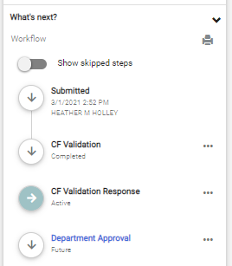
Requisition Workflow
FINANCIAL & BUSINESS SERVICES
Once submitted, the order has changed from a Cart to a Requisition.
The Requisition will route through workflow according to the workflow rules in the system.
For example: A Requisition greater than $10,000 will route to Purchasing
Note: All Requisitions will route through Departmental Approval for financial authorization
The GFA system determines who has the ability to approve this workflow step.
To see the Status of the Requisition look in the What’s Next section on the screen
The current Workflow step status will be Active
What’s next?
  Approvers will receive an email and system Notification (Action Item) to inform them of the required approval. Note that some approvers have turned off the email notification option and you may need to gently nudge them
To view who can approve the workflow step click On:
Peoplesoft & UShop communicating
  The name of the workflow Step
    For example Departmental Approval
Active
Note: The final workflow step in Requisition workflow is Create PO, when the system automatically creates and issues a PO.
  2022 | University of Utah | Financial Services

Slide 12
FINANCIAL & BUSINESS SERVICES
UShop Training Materials – Table of Contents
Shopper Training
Checklist
Requisition Workflow
Approving Orders
Purchase Orders
Change Orders
Invoicing & Payment
Closing Purchase Orders
Reports & Searching
Tips & Tricks
Help Resources
  2022 | University of Utah | Financial Services

Slide 13

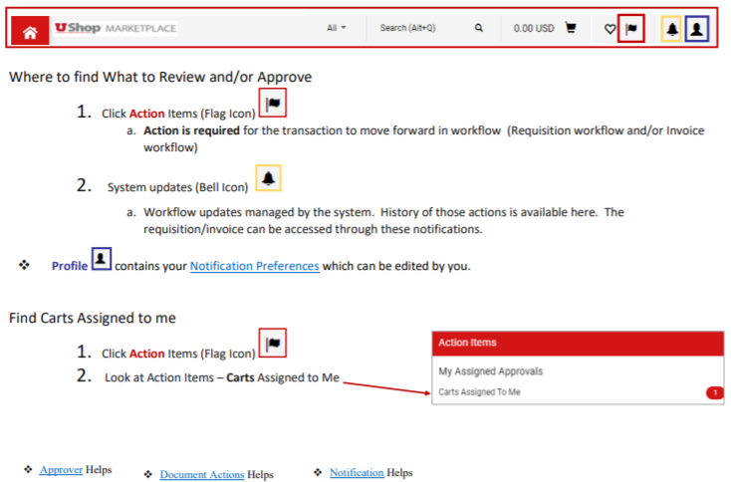
FINANCIAL & BUSINESS SERVICES
How to help your Approver
There may be times when an approver requires assistance from you, the Shopper or Requisitioner.
Below are links to help guides that can help you to assist them. Note these references are from One UShop
Where to find Requisitions to Approve (Action Items)
Where to click to Approve or Reject a requisition
Where to click to Return a requisition to the requisitioner for changes
Where to find system updates on requisitions they have approved
Too many emails – where to update Profile for
Notifications
How to Use Document Search to find Requisitions/POs
How to create reports
At the bottom of One UShop there are links to other helps
More detailed helps for Approvers are on the next 2 pages
  2022 | University of Utah | Financial Services

Slide 14
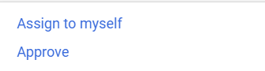
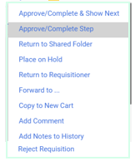
Approving Orders
FINANCIAL & BUSINESS SERVICES
The UShop system has many tools available for those who are required to provide Approval on a workflow step in Requisition and/or Invoice Workflow. The toolbar at the top of the UShop Home Page includes these icons to help guide you.
Action Items (Flag Icon)
Action is required for the transaction to move forward in Requisition workflow
If the requisition is ready to be Approved, after it has been reviewed, then click on the Options Dots
Click Approve/Complete
To access additional options such as Approve, Return to Requisitioner or Reject
    Make sure to begin by clicking on Assign to myself
Approve
Assign to Myself
  Then Click on the Options Dots a 2nd time to view the updated options
  Click on the Action Desired.
Approve/Complete Step
Return to Requisitioner
  Approve/Complete Step – to Approve the Requisition
  Return to Requisitioner
  Reject Requisition
Reject Requisition
  2022 | University of Utah | Financial Services

Slide 15
Approver Helps
FINANCIAL & BUSINESS SERVICES
System Notifications (Bell Icon)
Action is Not required.
However, when clicking on the System Notifications icon UShop informs the user of the most current actions which have occurred on their transactions.
This tool is helpful for viewing the current status of your Requisition, PO, or Invoice
Profile (Person Icon)
Details regarding your profile, notification methods and defaults are found in the Profile icon
Profile – Shows email address for your UShop account, such as name, email, phone, user name and role.
Notification Preferences – Select how the system will communicate with you. Notification preferences are available for Requisition, Purchase Order (PO) and Invoices
Default User Settings – Prior to shopping, Defaults can be set here for Accounting Distribution, Shipping Address and Cart Assignees.
Note that this is optional. The Accounting Distribution, Shipping Address and Cart Assignees can also be added during Proceed to Checkout
  2022 | University of Utah | Financial Services

Slide 16
FINANCIAL & BUSINESS SERVICES
UShop Training Materials – Table of Contents
Shopper Training
Checklist
Requisition Workflow
Approving Orders
Purchase Orders
Change Orders
Invoicing & Payment
Closing Purchase Orders
Reports & Searching
Tips & Tricks
Help Resources
  2022 | University of Utah | Financial Services

Slide 17

FINANCIAL & BUSINESS SERVICES
Purchase Orders
After you have submitted and/or approved a requisition you may wonder how to find the status of the Order.
The final workflow step for Requisition Workflow is for the system to create the Purchase Order (PO).
The UShop system will send the PO to the supplier electronically
For orders, which originate through Punch-out, the order/PO will be sent via CXML (computer to computer) to the supplier
For most orders, that are not Punch-out orders, the PO will be sent via email to the supplier
The exception is if the supplier is a manual distribution supplier or if the box for “prevent automatic distribution” has been selected
  2022 | University of Utah | Financial Services

Slide 18
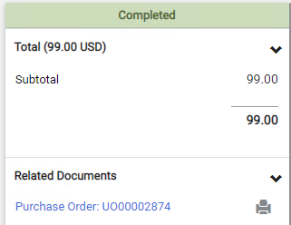

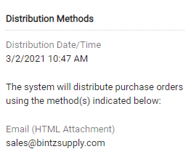
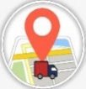
FINANCIAL & BUSINESS SERVICES
Purchase Orders – Where is My Order?
Where was the PO sent?
There are multiple ways to find the PO and PO information.
This slide will show you how to find your PO from the Requisition:
  Look at the Related Documents section
  Click on the Purchase Order number (this contains a hyperlink to the PO)
  On the PO, click on the Supplier / Distribution Information section of the Summary Tab on the PO
  Scroll to Distribution Methods. This will provide the information you need to know how and when the order, in the form of a PO, was sent to the supplier.
See Order Details:
Date & time the PO was Created
How the PO was sent to the supplier
Where the PO was sent
Email the order was sent to
PO’s can be sent via Email, Fax# or CXML
By clicking on the History Tab you can also view and confirm this information
  2022 | University of Utah | Financial Services

Slide 19
FINANCIAL & BUSINESS SERVICES
Purchase Orders – Where is My Order?
Punch-out Order
One benefit of shopping through a Punch-out supplier is the ability to track the order in the Punch-out as well.
The links below will take you to help guides specific to each of the Punch-out Suppliers
Click on the link for the supplier that the order was sent to
  Order Tracking for most Punch-out suppliers
  Amazon Tracking
Note: Should a return or replacement be necessary these can also be facilitated through the Punch-out
  2022 | University of Utah | Financial Services

Slide 20
FINANCIAL & BUSINESS SERVICES
UShop Training Materials – Table of Contents
Shopper Training
Checklist
Requisition Workflow
Approving Orders
Purchase Orders
Change Orders
Invoicing & Payment
Closing Purchase Orders
Reports & Searching
Tips & Tricks
Help Resources
  2021 | University of Utah | Financial & Business Services

Slide 21

FINANCIAL & BUSINESS SERVICES
Change Order Overview
There may be times when a change or update must be made to a PO.
      All changes must be made, by the department, for any PO which needs alterations.
      We hope these best practices and tips will assist in avoiding the need to Create a Change Order in most instances.
Best Practice:
Requisition is best completed when:
  Each PO line has a clear description, quantity, and price (received from the supplier).
  If Shipping, Handling or other fees will be charged, by the supplier, make sure that an individual Requistion/PO line is created for each item and includes the estimated costs.
  Accounting Distribution is set up in the way that the department would like the invoice paid.
    When using multiple funding sources, adding the Accounting Distribution at the individual PO line level will avoid misdistribution of monies.
PO is closed only after the final invoice has been paid:
  Review the Invoices Tab, on the PO, to make sure that the final invoice has been paid in full prior to any PO closure.
  Do not close the PO prematurely. Extra work will be required by you to re-open the PO if an invoice is received.
Note that Changes cannot be made against a PO that has been closed.
  2022 | University of Utah | Financial Services

Slide 22









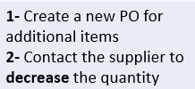





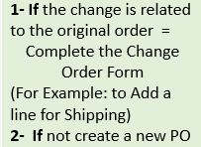

FINANCIAL & BUSINESS SERVICES
Change Order
When it appears that a change should be made to the PO there are several conditions that would effect
whether or not that change can be made. This Chart will assist you in determining the appropriate course of action.
Due to CXML Invoicing
If the change applies to the original order or for any other reason contact UShop@Utah.edu to work towards a solution.

Slide 23
FINANCIAL & BUSINESS SERVICES
UShop Training Materials – Table of Contents
Shopper Training
Checklist
Requisition Workflow
Approving Orders
Purchase Orders
Change Orders
Invoicing & Payment
Closing Purchase Orders
Reports & Searching
Tips & Tricks
Help Resources
  2022 | University of Utah | Financial Services

Slide 24
Invoicing & Payment - Overview
Once an order is received the supplier needs to be paid. Invoices are received and processed as described below.
Orders which originate from Punch-outs:
  The Supplier is paid via a CXML invoice which is sent from the supplier electronically to the University.
  No further action is required by the shopper/requisitioner once the order is submitted, the system manages the invoice and makes the payment.
Orders which originate from the Purchase Request Form (most other forms):
  The Supplier should send the invoice to ap@admin.Utah.edu per the instructions listed on the PO and per set up instructions.
  If the Invoice is sent to the department, then the department must send the invoice to ap@admin.Utah.edu .
  Make sure that the PO number is listed on the invoice.
  CC’ the supplier on the email which is sent to ap@admin.Utah.edu so that the supplier will be informed of when the invoice was sent to A/P
Orders with Internal Suppliers (departments):
  These Internal Suppliers handle the invoicing process themselves, so you don’t have to worry about sending an invoice to AP for processing.
  It’s already being taken care of for you.
  2022 | University of Utah | Financial Services

Slide 25
FINANCIAL & BUSINESS SERVICES
Invoicing & Payment - Approval
Certain criteria will trigger a required approval in order for the invoice to be paid.
Invoice Criteria which trigger approval:
When an Invoice total is greater than $50,000, Approval will be required through Invoice Workflow.
When “Hold for Invoice Approval” is checked on the Billing Tab, during Proceed to Checkout, this creates a required Invoice Workflow Approval step.
The invoice is related to a Sub-Award, as indicated by Account codes “628nn” through “629nn”.
Who can Approve an Invoice:
Those who are authorized to Approve the Invoice Workflow step are those with authority through the GFA system. This functions in the same way that Departmental Approval does in the Requisition Workflow.
The system will notify the Approver(s) that an Invoice requires Approval.
To Approve an Invoice:
To access the Action Items, begin by Clicking on the Flag Icon
Action Items (Flag Icon)
  2022 | University of Utah | Financial Services

Slide 26
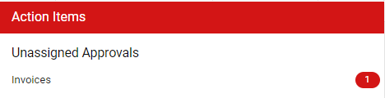

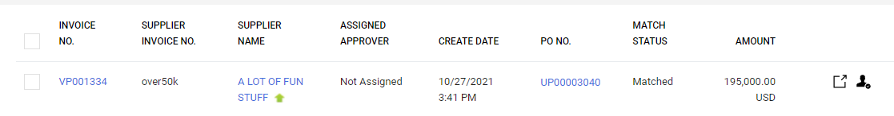
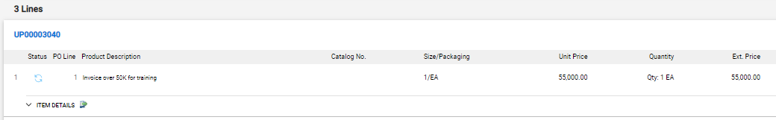

FINANCIAL & BUSINESS SERVICES
Invoicing – Approval
To Approve an Invoice:
From the Action Items (Flag Icon)
Click on Invoices
Click on the Approvals Folder to view the Invoices which await approval
List of Invoices to Approve will be listed. Note each Invoice awaiting approval begins with a V and has a hyperlink to the invoice
Scroll to see the line item detail for the Invoice.
V0001334
U0001334
To view the PDF Invoice from the supplier click on this link to OnBase
U0001334
Product Description
Unit Price
Quantity
Ext Price
Type in the PO number to view all invoice PDF’s for that PO
Note the Document Control Number in UShop to find the corresponding PDF from OnBase
Document Control Number
Document Control Number
  2022 | University of Utah | Financial Services

Slide 27
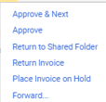
FINANCIAL & BUSINESS SERVICES
Invoicing – Approval
When ready to Approve:
Click on the Options Dots to see the options to Assign the Invoice to yourself or to Approve the Invoice for payment.
Note other invoice actions which are available.
Assign to Myself
Approve
Approve
When choosing anything other than Approve keep in mind that this may delay the payment to the supplier.
Timely payments from The University of Utah to the supplier are critical.
If payment ought to be on hold make sure to add a comment on the Invoice stating the reason for delayed approval.
To contact the A/P processor (A/P website will provide that information)/whomever the voucher was invoiced by. This will help A/P to assist you and the supplier.
  2022 | University of Utah | Financial Services

Slide 28

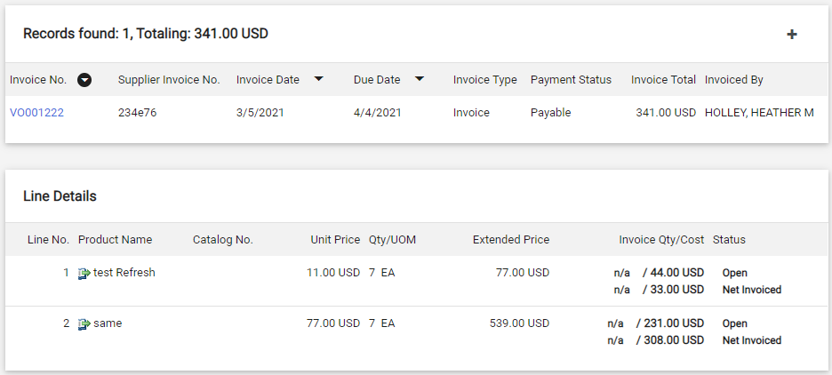
FINANCIAL & BUSINESS SERVICES
Invoicing – View Invoice Overview
You may wonder if A/P has received an Invoice and if it has been processed or paid.
This next section will display how to find this information.
Viewing an Invoice:
PO Number for the order
Begin by going to the PO and click on the Invoices Tab
Invoices
If an Invoice has been received and entered into UShop a number will appear next to the word Invoices in the Invoice Tab
Click on the Invoices tab to access the Invoices overview
To View a specific Invoice click on the Invoice number
To view overview of available vs spent dollars look in the line details
Invoice Definitions:
Open = Dollars remaining on a PO that still can be invoiced against. (Unvouchered or Not Invoiced)
Net Invoiced = Dollars which have been Vouchered/Invoiced against.
  2022 | University of Utah | Financial Services

Slide 29

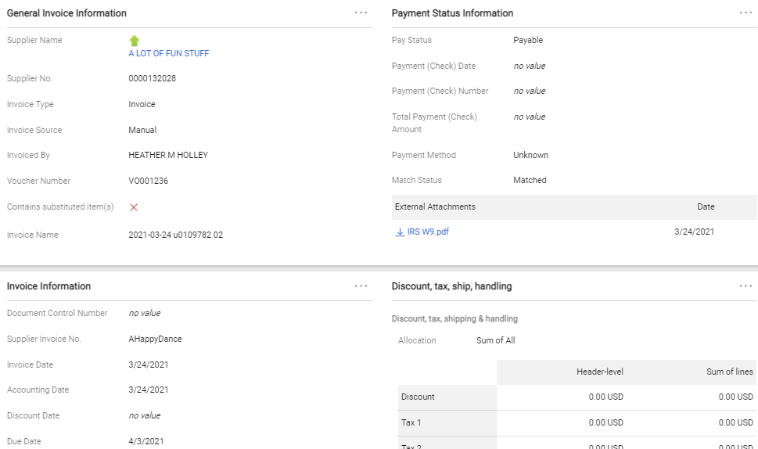
Invoicing – View Payment
FINANCIAL & BUSINESS SERVICES
Accessing the Invoice and Payment information is easy to do with one click from the Invoices tab on the PO.
To View a specific Invoice click on the Invoice number
Summary
Attachments
These fields will update after the payment is made in Peoplesoft
Payment (Check) Date
Date supplier was paid
Payment (Check) Number
Check Number from Peoplesoft
Total Payment (Check) Amount
Amount paid to the supplier
Payment Method
Check or ACH
A link to the Invoice which is found in OnBase appears here after the payment is made through Peoplesoft
This is the date the Invoice was entered into UShop
To view the Invoice prior to payment look in OnBase
This is the date the payment will be made to the supplier
For line level invoice detail,
keep scrolling down on this screen.
  2022 | University of Utah | Financial Services

Slide 30
FINANCIAL & BUSINESS SERVICES
UShop Training Materials – Table of Contents
Shopper Training
Checklist
Requisition Workflow
Approving Orders
Purchase Orders
Change Orders
Invoicing & Payment
Closing Purchase Orders
Reports & Searching
Tips & Tricks
Help Resources
  2022 | University of Utah | Financial Services

Slide 31


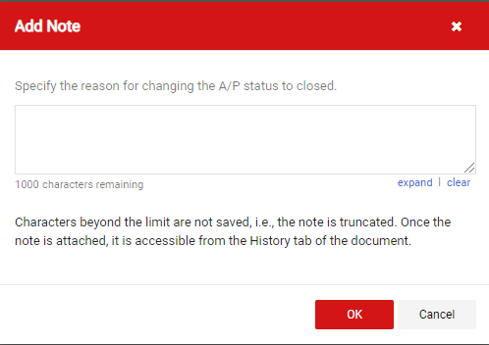
FINANCIAL & BUSINESS SERVICES
Closing Purchase Orders (PO’s)
There are a couple of things to know about if or when a PO should be closed
The PO should not be closed until the final Invoice has been paid in full
The PO will automatically close when the final 0.01 (penny) on the PO has been invoiced
Note that this means in many cases the PO will automatically close on your behalf.
PO’s which have been invoiced to the final 0.01 (penny) change to a state of Soft Close for 30 days to permit for potential Credit Memos. The system will change the state of the PO to Closed on the 31st day after the final 0.01 (penny) was invoiced.
Make sure that the final invoice has been paid in full (in which case you may not need to close the PO) prior to following the directions below.
To close a PO:
Go to the PO
Do not click on cancel. Choose the option to Close the PO
From the PO, click on the Options Dots
Click Close PO
Add a Note that explains the reason for closing the PO
For Example: Final Invoice Paid
Click OK
Note that the action of closing a PO will disencumber all unvouchered funds which remain on the PO
  2022 | University of Utah | Financial Services

Slide 32
FINANCIAL & BUSINESS SERVICES
UShop Training Materials – Table of Contents
Shopper Training
Checklist
Requisition Workflow
Approving Orders
Purchase Orders
Change Orders
Invoicing & Payment
Closing Purchase Orders
Reports & Searching
Tips & Tricks
Help Resources
  2022 | University of Utah | Financial Services

Slide 33


FINANCIAL & BUSINESS SERVICES
Report & Searching
The system has many tools to assist in searching for information regarding Requisitions, PO’s and Invoices
In addition to finding these documents it may also be helpful to create reports from the data in the system.
To Search:
Columns: When using Document search for Requisitions, PO’s and Invoices; it is important to know that there are different Columns for each document type.
It may be helpful to preset the Columns for each document type prior to searching for an order(s) with the information that would be most relevant to your daily needs.
For Example, in search by Requisition, having these Columns preset (pinned) may assist when searching desired transactions.
Filters: Filters allow for more in depth and specific searching of the data.
For example: Refine by Filtering by Org, Participant, Supplier, Invoiced, etc.
  Click on these links for assistance for formatting Columns, Filters , and searching for transactions.
Reporting:
Reports can be created by you. Reports created through the system can be exported to Excel
Reports can also be Saved, Scheduled to run at varying intervals and more
For assistance on creating reports click on this link
If there is a report you would like to create and desire assistance in setting it up please email UShop@Utah.edu and we will help you set it up
  2022 | University of Utah | Financial Services

Slide 34
FINANCIAL & BUSINESS SERVICES
UShop Training Materials – Table of Contents
Shopper Training
Checklist
Requisition Workflow
Approving Orders
Purchase Orders
Change Orders
Invoicing & Payment
Closing Purchase Orders
Reports & Searching
Tips & Tricks
Help Resources
  2022 | University of Utah | Financial Services

Slide 35
FINANCIAL & BUSINESS SERVICES
Tips & Tricks
Copy a Requisition to a New Cart
Chartfields at the PO line level – Page 2 of this link
Where is my Cart / What’s in my Cart
UShop only GFA
Has my Invoice been processed/paid? See Invoicing – View Invoice Overview and Payment
Link to PCard only list. These suppliers have informed us that they will only process a transaction with a credit card.
I’m getting too many emails. How to change Notification Preferences
How to change my email address for UShop
How to create a replacement PO
How to request payment. Email invoice to ap@admin.utah.edu
When a PO is created the funds are encumbered. The action of closing a PO will disencumber all unvouchered funds which remain on the PO
The PO owner receives all messages regarding the status of the order and/or payment. If you are replacing someone, and should be the new PO owner, email UShop@Utah.edu and let us know. We will update the PO owner.
  2022 | University of Utah | Financial Services

Slide 36

FINANCIAL & BUSINESS SERVICES
Default User Setting Options
Default options for the Shipto Address, Accounting Distribution and Cart Assignees can be set up prior to order creation
Shipto Address Defaults:
Multiple default shipto addresses can be added. Note that one shipto address must be selected as the default address.
  Click this link for instructions on how to add Default Shipto Addresses
If the address that is needed is not found, then email ushop@utah.edu and cc’ askme@purchasing.utah.edu . Provide the address and /or 10 digit code to be added
Accounting Distribution Defaults:
Multiple default Accounting Distributions can be added if desired
    Click this link for instructions on how to add Default Accounting Distributions
It is wise to ensure the GFA is set up with the proper person(s) with rights to approve prior to setting up the default Accounting Distribution. This will assist the order in being placed in a more timely manner.
Cart Assignee Defaults:
Multiple default Assignees can be added if desired. This may be helpful especially for those with the role of Shopper
  Click this link for how to set up Default Cart Assignees
  Note that only those with the role of Shopper or Requisitioner can be selected as a Cart Assignee
  2022 | University of Utah | Financial Services

Slide 37
FINANCIAL & BUSINESS SERVICES
UShop Training Materials – Table of Contents
Shopper Training
Checklist
Requisition Workflow
Approving Orders
Purchase Orders
Change Orders
Invoicing & Payment
Closing Purchase Orders
Reports & Searching
Tips & Tricks
Help Resources
  2022 | University of Utah | Financial Services

Slide 38
FINANCIAL & BUSINESS SERVICES
Help Resources
We are here to help when you have questions or need help. Please contact us:
By Email at ushop@utah.edu
By calling 5-CALL (801-585-2255)
IM via reach the UShop team on Teams
Self help links
Main help document One UShop
Link to Shopper Training
Online Training & Reference Materials
Link to Approver Training
  2022 | University of Utah | Financial Services

Slide 39
      UShop Requisitioner training is now complete.
      Go here to complete and submit an Activation Request form
  2022 | University of Utah | Financial Services

