Slide 1
Procurement to Pay Tutorial
Accounts Payable
General guidelines for payments made with University funds on Limited Purchase Orders, Limited Purchase Checks, & Payment Request

Slide 2
Accounts Payable Functions
What We Do:
Expenditure Review
Department & Vendor Relations
Voucher Processing
Payment Processing
Auditing
1099 Reporting
Duplicate transactions
Stale-dated payments
Document Imaging
Form Distribution
Limited Purchase Orders (LPO’s)
Limited Purchase Checks (LPC’s)
Campus Orders
Campus Order Processing

Slide 3

Direct Deposit/ACH Info.
Payments can now be made by Direct Deposit rather than by check.
Direct Deposit is available for all vendors who are in the Accounts Payable Vendor Master table.
This payment method does not affect payroll and is not associated or coordinated with Payroll Department’s direct deposit options or Income Accounting student loans.
There are no checks or paper advices for this distribution. The payment will be deposited directly to the payee’s checking or savings account and an email containing the payment advice will be sent to the payee.
Once the vendor or student is set up under this payment method, they must notify Accounts Payable in writing if they wish to change the account information or to opt out.
A Stop Payment can be made on a Direct Deposit payment if the ACH is notified within five working days of the date of payment.
Direct Deposit Form

Slide 4
Table of Contents
Course Objectives
Policy Information
Limited Purchase Order (LPO)
Limited Purchase Check (LPC)
Payment Request (PR)
Appendix
Additional AP Resources
Other AP Training Available
Stop Payment Information
GO
GO
GO
GO
GO
GO

Slide 5

Course Objectives
After this course, participants will be prepared to:
Properly use Limited Purchase Orders, Limited Purchase Checks, & Payment Request to make payments.
Prepare these procurement documents so expenditure review by Accounts Payable is expedited.
Back to Table of Contents

Slide 6
Policy Information
University Policy provides guidelines for small dollar purchases. You are responsible for following these policies when you make purchases. The Purchasing Department maintains contracts with many suppliers for all kinds of merchandise. In addition to University contracts, the state has contracts that are available. Using these contracts could mean substantial savings. Please view http://www.generalservices.utah.gov/statewidecontracts/Contracts.aspx for additional information or call the Purchasing Department to speak with the appropriate buyer for help with identifying these sources.
A part of your purchasing responsibility includes compliance with the University’s policy governing Small, Minority and Woman-owned Businesses (See University Policy 3-100:III.D.4). Contact the appropriate buyer in Purchasing for commodity-specific information.
Back to Table of Contents

Slide 7
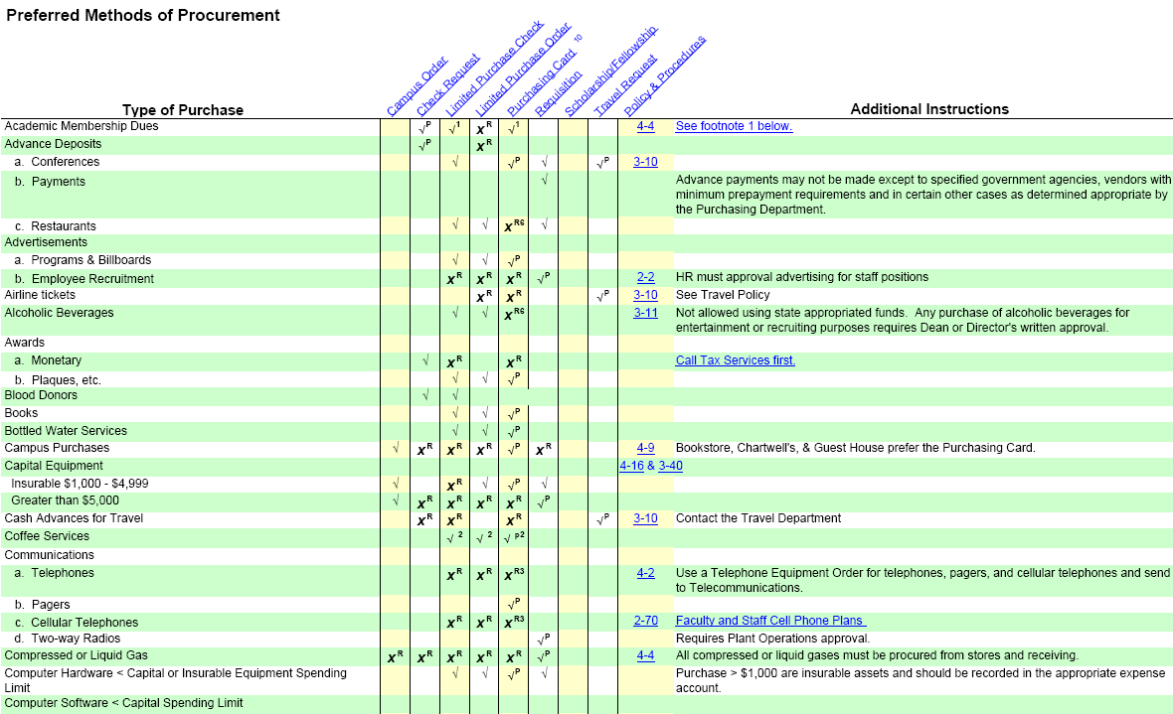

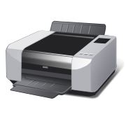
Procurement to Pay Methods
The Preferred Methods of Procurement is an excellent quick reference guide which helps in determining which financial instrument can be used to make a purchase.
Printable Version

Slide 8
Financial Documents
Limited Purchase Order (LPO)
Limited Purchase Check (LPC)
Payment Request (PR)
GO
GO
GO
The total time needed to complete the entire tutorial is approx. 30 minutes.
Throughout the tutorial, hyperlinks are shown in blue text. The escape key on your keyboard will take you out of the tutorial at any time.

Slide 9

LIMITED PURCHASE ORDERS
(LPO)
Back to Table of Contents
How to fill out the LPO Agreement
Obtaining LPO’s
How to fill out and use an LPO

Slide 10
LIMITED PURCHASE ORDERS
The Limited Purchase Order (LPO, LO) is designed to make small dollar procurements. See University Policy 3-191.
It is intended for one-time transactions between the University and an outside vendor.
Use a Requisition if the agreement includes incremental services or deliverables and the vendor expects installments or more than one payment.
One order may be placed for each LPO. The total order, including any back ordered items, cannot exceed $5000.
LPO’s are numbered in the following format: LO-XXXXXX. The LPO number appears on every copy of the LO and should be used by the vendor on all related invoices, correspondence, etc.

Slide 11
WHEN TO USE AN LPO
Alcoholic Beverages (See Policy and Procedures)
Advertisement Programs and billboards
Award Plaques
Blood Donors
Books
Computer Hardware (less than capital spending limit)
Computer Programs and Licensing (less than capital spending limit)
Employment Agency Temporary Services
Equipment (One-time Rental/Payment )
Flowers
Food for Business Meals, Office Functions and Recruitment
Freight
Insurable Equipment ($1000-$4999)
Lab/Office Supplies
Maintenance Agreements
Medical Services
Printing & Copying or Photographic Slide Reproduction
Restaurants (Banquets and Catering)
Services such as Repairs (custodial and plant maintenance)
Vehicle Rentals
Consult the Preferred Methods of Procurement Chart for limitations.

Slide 12
HOW TO OBTAIN LPO’s
To obtain blank Limited Purchase Orders, you must complete a written LPO agreement. Click here to open a .pdf copy of the form. It is also available on the Accounts Payable website.
Limited Purchase Order forms can be picked up in Accounts Payable but cannot be sent through Campus Mail or USPS mail.
The person who picks up the blank forms does not have to be the authorized signatory or the LPO custodian, but they must have a valid University ID.
The LPO custodian and an authorized signatory must sign the agreement and be on the Signature Card records in both Accounts Payable and Purchasing.
Each request for LPO’s must be on an original form and include the appropriate original signatures.

Slide 13
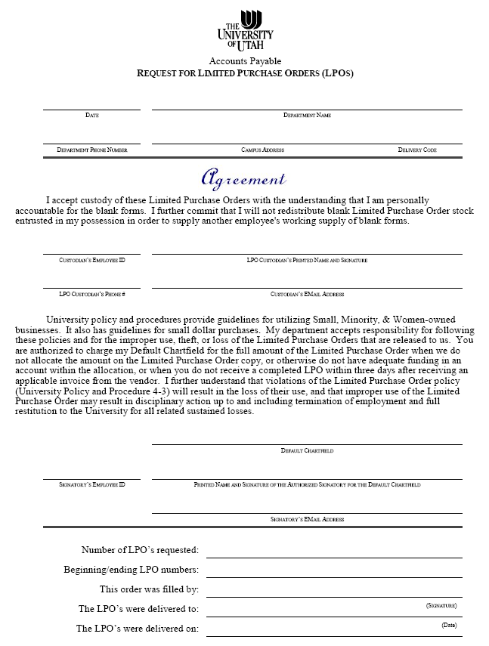
THE LPO AGREEMENT
* Your delivery code can be found on the Employee page in the CIS or you can call Purchasing.
Section 1:
Fill in:
Dept. name & phone
Campus address
Delivery code* (the receiving department uses this code for delivering items they receive with your LPO number on the packaging slip)
Section 2: LPO Custodian
Fill in:
Name & University ID#
Phone & Email address
Section 3: Authorized Signatory
Fill in:
Default chartfield
Signatory name & signature
Email address
Section 4: AP USE ONLY

Slide 14
HOW TO FILL OUT THE LPO
Section 1: The vendor’s Tax ID
Enter the vendor tax identification number here.
Section 2: Expenditure Description
Business meals, refreshments, recruiting, or entertainment expenses must include the names of the attendees (if less than 10) or the group and number in attendance, a detailed description of the business purpose, and the date(s) of the function. Approval of the next higher authority is required.
Section 3: Foreign Vendors & the Chartfield
The foreign section must be filled in and marked NO. Foreign vendors cannot be paid with an LPO; use a Check Request.
If the vendor is not in the Vendor Master, then an IRS Form W-9 is required before payment.
A Dean or higher must approve the expenditure if alcohol is served, or the purpose of the meeting is recruiting or entertainment.
Enter complete chartfield information and amount or percentage to apply to each line. Note that the total cannot exceed $5000.
Property Accounting is required to approve the payment if the chart field account starts with “61” or if the LPO is greater than $1000. Required chartfields left blank, amounts incorrectly allocated, any lines with accounts 10400 or 10500 or accounts starting with a“3” or “5” will be charged to the default chartfield string. The default will also be charged if AP does not have a copy of the LPO to match with the invoice.

Slide 15
HOW TO FILL OUT THE LPO
Section 4: Dept. & Payee Information
Enter department /project name, location, your name and telephone number, and date the order was placed. The invoice must be dated within 6 months.
Enter details about items ordered.
Section 6: Authorized Signature
If delivery will be made via the Receiving Department, put the ship-to code in the Deliver / Ship to box and forward a copy to the Receiving Department.
Section 5: Item/Purchase Description
See The Preferred Methods of Procurement Chart for limitations on items that may be purchased.
Check whether the order was placed by phone and other details as necessary.
Section 7: Sales Tax Exemption
The “Authorized Signature” must be on a signature card in Accounts Payable and must be either the Principal Investigator, Account executive, Department Chair/Head, dean/director or authorized alternate. This might not be the same signature as described earlier for business meals.
The University is exempt from Utah sales and use taxes. Our tax exemption number is printed on the LPOs. The sales tax exemption certificate does not apply to purchases outside of Utah. Note we have recently obtained a new Tax Exempt number.
*Our new tax exempt # is: 1187443-002-STC

Slide 16
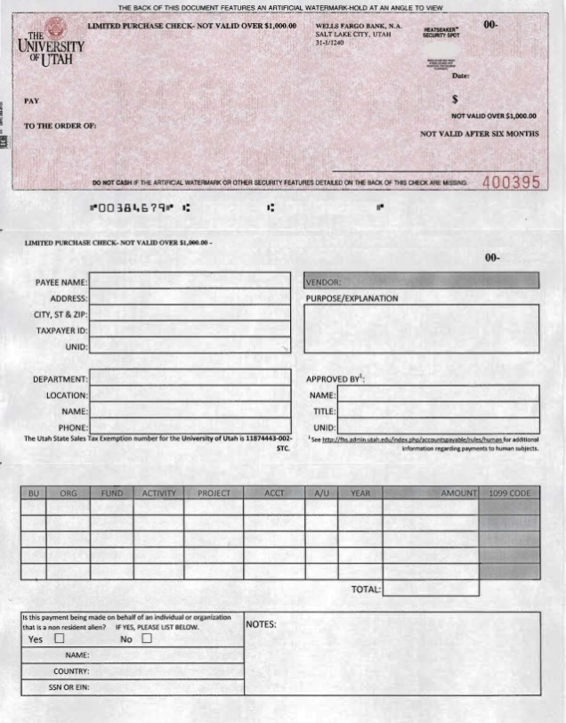
LIMITED PURCHASE CHECKS
(LPC)
Back to Table of Contents
How to fill out the LPC Agreement
Obtaining LPC’s
How to fill out & use an LPC

Slide 17
LIMITED PURCHASE CHECKS (LPCs)
The Limited Purchase Check may be used by a department for payments to a human subject up to the limit printed on the face of the check (currently $1000 in most cases).
LPCs are prepared by the ordering department and are delivered (or mailed) to the vendor without preparing a requisition or obtaining approval of the Purchasing Department.
Please refer to the Limited Purchase Check User Guide located on The Accounts Payable Website.
Any further questions regarding LPC’s may be directed to the LPC Administrator at 581-5748 or Accounts Payable 581-6976.

Slide 18
OTHER LPC CONSIDERATIONS
Limited Purchase Checks are highly negotiable and should receive the same security measures as cash.
If an LPC fails expenditure review and Accounts Payable has to perform additional tasks to get the documentation into a recordable state, a $12.00 processing fee will be charged to the LPC’s default chartfield.
Persistent improper use of the LPC will result in withdrawal of privileges to use these checks, and may result in disciplinary action for fraudulent use.
The checks must be retained in a secure place, out-of-sight in the ordinary course of business, and the checks must not be signed until issued.
If a check is lost or stolen, the department must notify Accounts Payable immediately.
If an LPC violates the University’s Policies outlined in the User’s Guide, a $12.00 processing fee will be charged.

Slide 19
ALLOWABLE LPC EXPENDITURES
Blood donors and study participants
(First payment must include an IRS Form W-9 . A subsequent Form W-9 is required if the Human Subject’s name, address or backup withholding status changes.)

Slide 20

LIMITED PURCHASE CHECKS
The original check stub:
The Accounts Payable copy:
The department copy:
Goes to the payee/vendor.
A complete copy including a copy of the check should be attached to the study patient reimbursement form and/or original receipt plus all related documentation should be forwarded to Accounts Payable, 145 Park. If the receipt measures less then 8.5 inches by 2.75 inches, kindly tape the receipt to a plain white sheet of paper. (This makes our scanning process much faster.)
Should be retained by the department.
Do not send the bottom stub because it contains sensitive data related to our accounting system. This structure and information is proprietary to the University information systems and is not generally known. If you need to send confirmation material to the vendor it should be in another form.

Slide 21

THE LPC POSITIVE PAY SYSTEM
The LPC Custodian must use the online Positive Pay System to report checks to the bank as they are issued by the department.
A check is considered issued when it has been released to the Payee. (A check that has been prepared, yet remains in the custody of the Custodian is not an issue.)
Positive Pay is covered in the monthly LPC class held by the LPC Administrator in the Park Building and information is also available online via the LPC User’s Guide.

Slide 22
HOW TO OBTAIN LPC’s
To obtain blank Limited Purchase Checks, you must complete a Limited Purchase Check Agreement form (available on the Accounts Payable website).
Limited Purchase Checks can be picked up in the Accounts Payable Department. Blank check stock cannot be sent through Campus Mail or USPS mail.
The LPC custodian and an authorized signatory must sign the agreement and be on the Signature Authorization records in both Accounts Payable and Purchasing. The LPC custodian and the authorized signatory can be the same person.
The person who picks up the blank checks must have a valid University photo ID.
Each subsequent request for LPCs must be an original form and include the appropriate original signatures, as well as a check. A check register is also required if a custodian must return all or part of their check stock.
New custodians are required to attend an LPC class which is held monthly in the Park Building. Current users are also welcome to attend. Because space is limited, please register at the Financial & Business Services website.

Slide 23
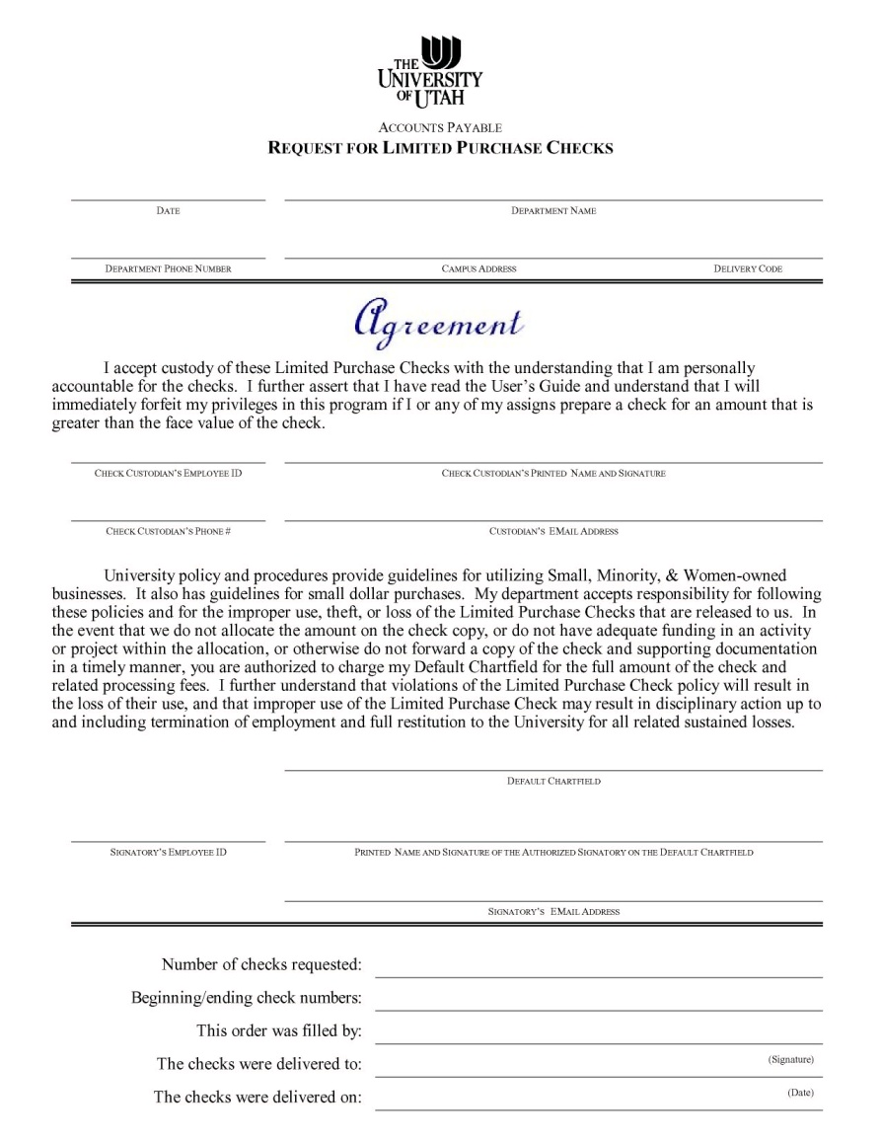
THE LPC AGREEMENT
Section 1:
Fill in:
Dept. name and phone
Campus address
Delivery code* (the receiving department uses this code for delivering items they receive with your LPC number on the packaging slip)
Section 2: LPC Custodian
Fill in:
Name and University ID#
Phone and Email address
Section 3: Authorized Signatory
Fill in:
Default chartfield
Signatory name and signature
Email address
Section 4: AP USE ONLY
* Your delivery code can be found on the Employee page in the CIS or you can call Purchasing.

Slide 24
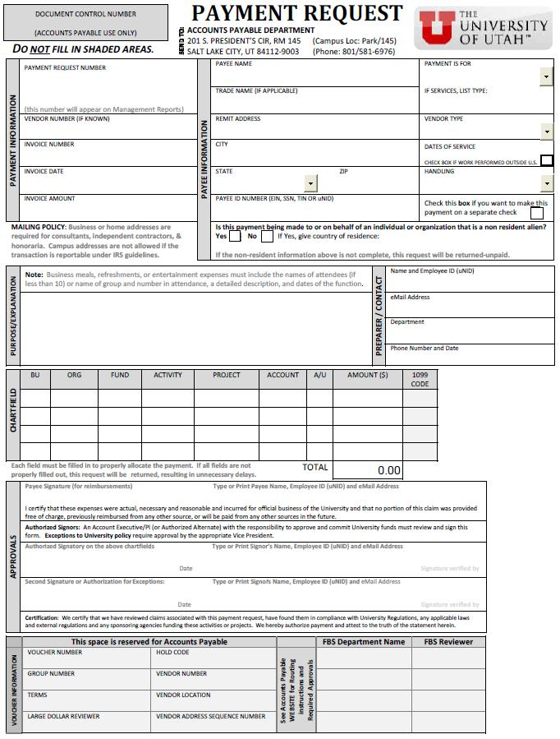
Payment Request
(PR)
Back to Table of Contents
Types of expenditures paid on a Payment Request
How to fill out a Payment Request

Slide 25
Payment Request (PR)
A Payment Request may be prepared for any dollar amount.
It is intended for a one time transaction between the University and an outside vendor. Use a Requisition if the agreement includes incremental services or deliverables and the vendor expects installments or more than one payment.
A Payment Request is preferred to pay individuals for services, employee/student refunds, reimbursements and membership dues.
The Preferred Methods of Procurement Chart lists other items which can be purchased with a Payment Request.
General Accounting must approve all Payment Request over $1,000.
Grants and Contract Accounting must approve Payment Request being paid out of project funds.

Slide 26
EXPENDITURES REQUIRING A PR
Consultants.
A Professional Services Agreement is also required.
Guest lecturers.
A Guest Lecturer/Performer Agreement is also required.
Independent contractors.
A Professional Services Agreement is also required.
Performers (Individual and Group) .
A Guest Lecturer/Performer Agreement is also required.
Honorarium
An honorary payment made on a special and non-routine basis to an individual who is not an employee of the university to recognize outstanding achievement, demonstrate respect or esteem for the individual’s status or position, or to acknowledge the contribution of gratuitous services to the university. It does not include prizes and awards to university personnel. Click here for Honorarium guidelines.
Please review:
University Regulations Policy 3-111 Independent Consultant and Independent Contractor
Professional Service Agreements
University Regulations Policy 3-062 Honorarium Payments

Slide 27
WHERE TO FIND THE PR
The Payment Request is available on the Accounts Payable website. Click here for an auto-numbered .pdf of the Payment Request Mac users click here for an un-numbered Payment Request.
Accounts Payable will assign a PR number to a Payment Request received without one.
All Payment Request forms can be found at http://fbs.admin.utah.edu/index.php/accountspayable/forms/onlinecheck/

Slide 28
HOW TO FILL OUT THE PR
Section 1: Payment Information
Fill in:
Vendor Number: If known, other wise leave blank.
Invoice Number: Appears on the back up documentation. Otherwise, enter a unique value if no invoice number is available.
Invoice Date: Date on the invoice or the date this expenditure is approved if no invoice is available.
Section 2: Payee Information
Fill in the payee’s name and/or business name, and the remit address.
If “Yes”, supply country of residence; if “Yes” is checked, the CQ will be sent to Tax Services for approval.
Select the payment type from the menu.
Select the payee type from the menu.
Foreign Vendor Box: Check “Yes” or “No”.
Check the separate payment box if you do not want this payment to be grouped with other payments due at the same time to the vendor.
Income Amount: State the amount of the total invoice.

Slide 29
HOW TO FILL OUT THE PR
Section 4: Purpose Explanation
A complete explanation is required. Failure to provide a detailed explanation will be returned unpaid.
Section 5: Preparer/Contact
Complete all fields otherwise it will delay the payment process.
Section 6: Chartfield
Complete the chartfield columns as necessary. Do not enter a 1099 code.
Reimbursement request for allowable out-of-pocket business meals must be made within in 60 (sixty) days to the event.
Purpose/explanation should be descriptive, indicate the number of attendees, business purpose of the meeting and the dates, etc.
The Payment Request must have the documentation required by the type of transaction. All agreements and contract must be included.

Slide 30
HOW TO FILL OUT THE PR
Section 7: Approvals
Payee Signature for reimbursements: This is required for all employee/student reimbursements, including a readable print of their name/UID, and email address.
Section 8: Approval Signatures
All Payment Requests must be signed with an original signature and the signatory must be on file in Accounts Payable unless the signatory is a Department Chair or above.
If alcohol was served, the Dean or higher must also sign for the approval.
All Payment Requests must be signed with an original signature and the signatory must be on file in Accounts Payable unless the signatory is a Department Chair or above.
If alcohol was served, the Dean or higher must also sign for the approval.
Note: A further detailed overview can be found on our website under Expenditure Review- Payment Request.

Slide 31

TRAVEL RELATED PR’s
Accounts Payable can pay only the following travel related expenses on a Payment Request:
Immunizations
Passports
Visas
Local mileage
Local conference registrations
For all other travel related expenses, the department must register the trip, obtain a travel number, and submit payment requisition to Travel Department.
See the next slide for a flowchart to submitting travel related payments.
Click to view Travel’s Website

Slide 32
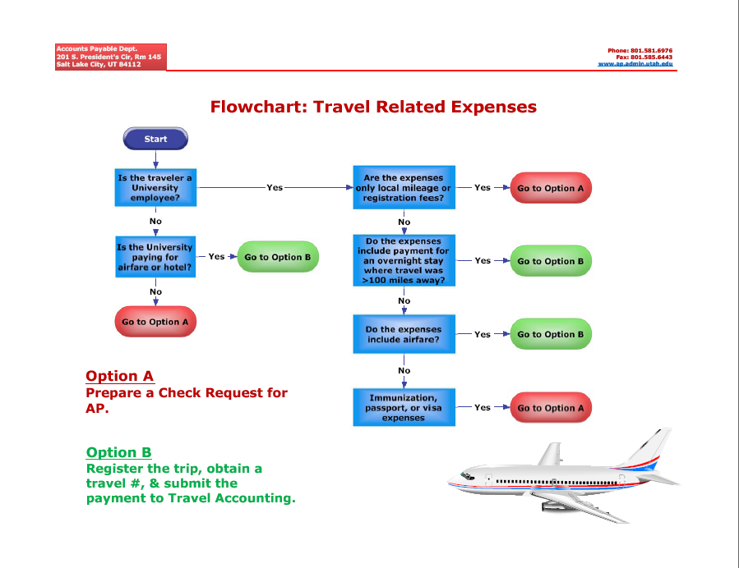

FLOWCHART FOR TRAVEL PAYMENTS
Printable Version of Flowchart
Click to view Travel’s Website

Slide 33
NEXT DAY PR’s
If needed, Accounts Payable can expedite a payment to a vendor.
A payment can be created typically within one business day of receiving the Payment Request.
A handling fee of $12 must accompany all requests for 'Next Day' checks. This can be paid with cash, an offset against the payable amount, or a Campus Order.
Next Day requests received before 1:00 PM:
The check will be available the following morning of the next business day - provided the Check Request passes expenditure review and all approvals are in order.
Next Day requests received after 1:00 PM:
We will do our best to process the request & create a check or payment on the next business day. If we cannot, the request will be processed the next business day, and the check or payment will be prepared on the following day.
A SAME DAY Check is also available.
A handling fee of $24 must accompany all requests for ‘Same Day' checks. This can be paid with cash, an offset against the payable amount, or a Campus Order.
All requests for “same day” checks must be hand delivered to an Accounts Payable supervisor, and will be handled responsibly on a case-by-case basis depending upon available resources.

Slide 34
APPENDIX
Additional AP Resources
Stop Payment Information
Other Accounts Payable Training Available
GO
GO
GO
Back to Table of Contents

Slide 35

STOP PAYMENT INFORMATION
If a check has been lost, or needs to be replaced or voided, fill out a Stop Payment Form. This way, Accounts Payable has a written record of the void or reissue and a record of the reason for the stop payment.
Fax/Send completed form to AP. Include a valid reason for voiding the check, mark whether the check should be reissued or simply voided. Include the check if possible.
It is also acceptable to mark “VOID”, the reason for the stop, your name and phone number directly on the check and deliver it to AP.
The Stop Payment Request Form can be found on the AP website.
Stop Payment Form

Slide 36


ADDITIONAL TRAINING AVAILABLE
Financial & Business Services offers a wide variety of training classes.
Click here to see all available FBS classes.
Click here for Limited Purchase Check class availability or to register.

