Slide 1
RFTrack Asset Tracking Software for Capital and Noncapital Assets

Slide 2
Legislative Auditor Report on Noncapital Assets July 2018
Reviewed all of Higher Ed
Noted the Lack of Noncapital Inventory Controls at most institutions
Noncapital Assets Are Not Tracked
Institutions Are Not Monitoring Noncapital Asset Policy Compliance
Vague Institutional Policies Do Not Provide Sufficient Guidance
The University of Utah had a policy and tracked noncapital assets but variability of compliance by departments

Slide 3
Utah System of Higher Education Policy R572, Noncapital Asset Inventory and Tracking November 2018
Maintain an inventory of the following noncapital assets
Assets with an acquisition cost greater than or equal to $3,000
Institution-owned computers and laptops that may contain PII
Update the list along with a designated custodian annually
Inventory annually
Report lost or stolen noncapital assets to the department supervisor
Provide a list of missing items to central administration annually

Slide 4
University of Utah Noncapital Inventory Action Plan
Update University of Utah Policy 3-041:Accountability for Noncapital Equipment in accordance with the USHE Policy
Noncapital Equipment will include equipment having an acquisition cost or donated value of greater than or equal to $3,000, but less than the $5,000 capital threshold and with a useful life in excess of one year.
Noncapital Equipment will also include institution owned computers, laptops and tablets that may contain PII.
Provide departments with a barcode scanning system as recommended in the audit report
Designate a department liaison as a point of contact for inventory compliance
Capital Assets will continue to be accounted for in PeopleSoft Asset Management.
BU01 threshold is $5,000
BU02 threshold is $3,000

Slide 5
University of Utah Noncapital Inventory Action Plan
RFP for Asset Scanning System– Issued in September 2019 in accordance with University Software Policy 4-050 University Enterprise Software Rule
Information Security Assessment by UIT
RFP awarded to inLogic for the RFTrack System in January 2020
Capital Assets will continue to be accounted for in PeopleSoft Asset Management.
RFTrack interfaces with PeopleSoft and automates the physical inventory of capital assets
RFTrack may also be used by departments to track and inventory noncapital assets
Departments may continue to use other systems for noncapital assets
ServiceNow, Fishbowl, - Provide a complete listing of noncapital assets and results of annual inventory to the Property Department by May 31st of each fiscal year

Slide 6
RFTrack Inventory Process – Capital Assets
Capital Assets
Capital Asset physical inventories waived for FY2021 due to COVID
Capital Asset inventories will resume for FY2022
Capital Assets will continue to be maintained in PeopleSoft with daily updates to and from the RFTrack inventory system
Certain fields may be edited in RFTrack and update back to PeopleSoft- manufacturer, model, description, location, tag number, serial number
Annual Inventory entry required for each asset– manual entry or scanner entry
Scheduled on a rotational basis throughout the fiscal year (August 2021 to May 2022)
Schedule on Property Accounting website
Property Department has 5 loaner scanners that may be used to retag and perform inventories

Slide 7
RFTrack Inventory Process – Capital Assets
Capital Assets
Capital Asset information is already available in RFTrack
Request access – CIS Single Sign On
Email mark.hamilton@admin.utah.edu
View / Update information
May enter an asset inventory manually until assets are retagged. Manual inventories may be the preferred method for organizations with just a few capital assets
Retag Assets with RFID Tags
Red for Capital Assets $5,000 or greater
For nonmetal surface assets
For metal surface assets
Specialty tags also available – small metal tags for servers, large tags for distance, etc.

Slide 8
RFTrack Inventory Process – Noncapital Assets
Noncapital Assets may be maintained in RFTrack
Streamlines required annual inventory process for capital and noncapital assets
Noncapital Computer related assets that are inventoried and tagged in IT systems such as UIT’s ServiceNow, Fishbowl, etc.
Do not need to be tracked in RFTrack
No Property Department Inventory Tag required
RFID Tags
Yellow for Noncapital Assets $3,000 - $4,999
Each color will have 2 tag types
For nonmetal surface assets
For metal surface assets
Specialty tags also available – small metal tags for servers, large tags for distance, etc.
Non-RFID Black Barcode Tags
Computer related assets that are not track in separate IT systems such as ServiceNow
Other discretionary equipment less than $3,000, not required by policy
Barcodes may be scanned by same RFID/Barcode scanners

Slide 9
Noncapital Asset Upload Template-Fields Include Required and Main Asset Fields
Noncapital assets may be manually entered into RF Track or with an Excel Upload Template
Asset fields Include
Tag Number, Asset Description, Location Code
Category, Class, In Service Date
Total Cost, Org ID, Organization Name
Manufacturer Name, Model, Serial Number, Source Document
Inventory Controller, Email Address
BU, Status, Department as Host System

Slide 10
CAPITAL and NONCAPITAL ASSET TAGS
The CAPITAL ASSETS, $5,000 or greater, will continue to use the red tag format:
The NONCAPITAL ASSETS, $3,000 to $4,999, in RFTrack will continue to use the yellow tag format:
The Black Barcode Tags, used for computer related assets not tracked in other systems, and other discretionary assets less than $3,000, not required in policy
Metal tags for IT (laptops/desktops) and metal or very near metal asset surfaces | Non-metal tags for asset surfaces such as plastic, wood, glass, etc., or > 1” away from metal

Slide 11
RFID Tracking Software
RFTrack Software Modules
Server
Mobile
Monitoring – Available
Check-Out

Slide 12
RFTrack Server
Web-based with no software on user’s workstation
Departments can manage asset information on location, asset description, manufacturer, model serial number and tag number
Data import/export from PeopleSoft
Custom fields
Pictures of assets and documents
Reporting

Slide 13
RFID Scanners
Zebra 3330R
Reads both RFID and Barcodes Tags
RFID is 15 to 20 times faster than manual processes reading up to 20 tags simultaneously
Quickly locates missing assets
Property Department will have a few scanners that can be checked out
Departments can purchase for around $4,900

Slide 14
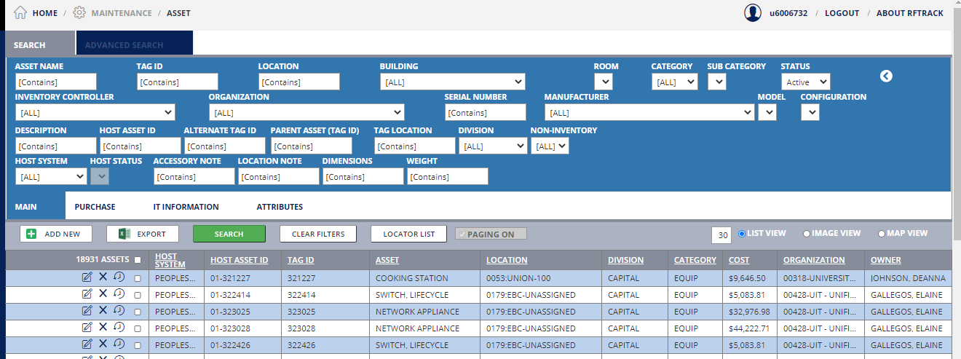
List View – Shows Assets – Can Filter

Slide 15
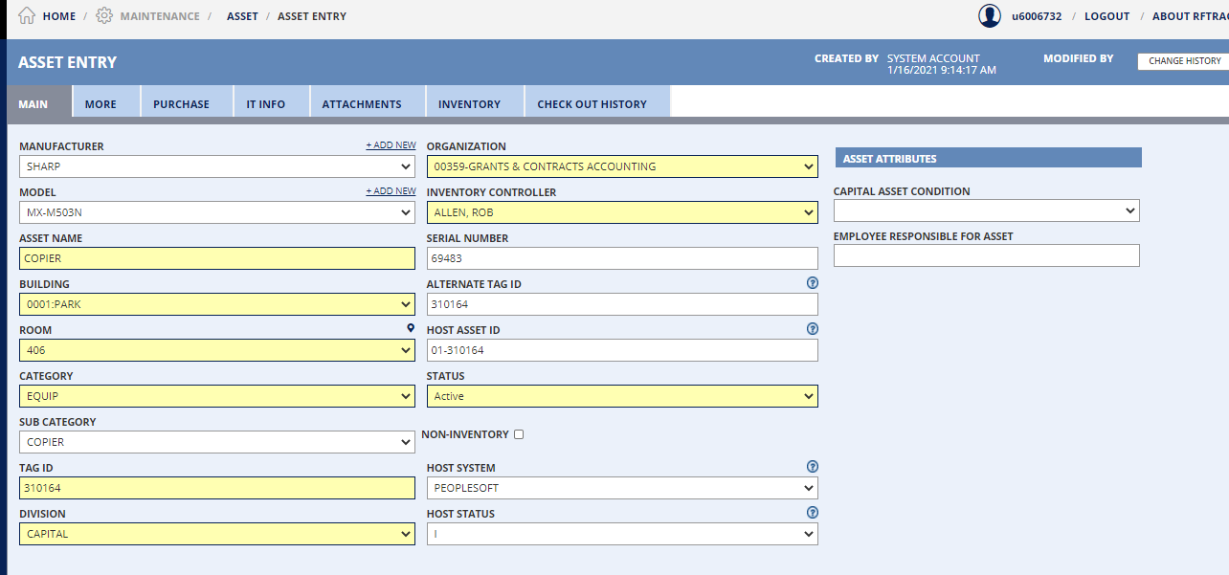
Asset Tabs Group Asset Fields

Slide 16
Property Accounting Website
RFTrack Inventory System
RFTrack Training Guide and Video Tutorials
Text Instructions of Video Tutorials
Noncapital Inventory Upload Template

Slide 17
Department’s Responsibilities
Assign an Inventory Controller.
Complete annual inventory of capital and noncapital equipment.
Reinforce University policies and procedures within the department.
Tag new equipment.
Throughout the year, advise Property Accounting regarding the changes to capital assets by completing property forms.
Maintain the accounting for noncapital assets.
Provide annual noncapital asset listing to Property Accounting by May 31st
Report annually on lost or stolen equipment.

Slide 18
Property Department Contact Information
Mark Hamilton – Project Manager for the Noncapital and Leasing Projects
mark.hamilton@admin.utah.edu
(801) 213-1401
Robin Love – Property Accountant Coordinator for Capital and Noncapital Asset Inventories
robin.love@admin.utah.edu
(801) 581-3973
Robert Allen – Manager Property Department
robert.allen@admin.utah.edu
(801) 581-5635

